Slide 1
Temperature Regulation
Jed Wolpaw MD, M.Ed
February 4, 2016

Slide 2
Outline
Hypothermia: Etiology, Prevention, Treatment, Complications
Effect of Drugs/Anesthesia on Temperature Regulation Temperature
Heat Loss; Mechanisms
Temperature Regulating Centers
Heat Production and Conservation
Body Temperature Measurement; Sites; Gradients
Nonmalignant Hyperthermia syndromes; Complications, Treatment
Fever facts

Slide 4
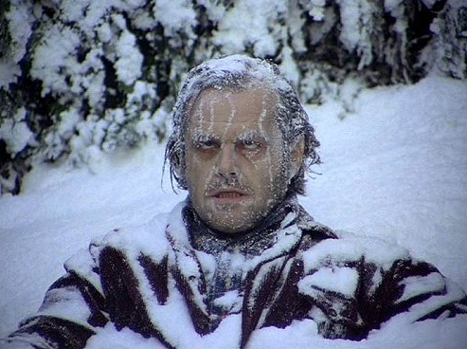
Hypothermia
What is the definition of hypothermia?
A: When you look like this guy
B: Core temp below 36
C: Core temp below 35
D: When you’re so cold that when you inhale forcefully through your nose your nostrils freeze together

Slide 5
Hypothermia
What is the definition of hypothermia?
A: When you look like this guy
B: Core temp below 36
C: Core temp below 35
D: When you’re so cold that when you inhale forcefully through your nose your nostrils freeze together

Slide 6
Hypothermia
Which of the following is not an adverse effect of intraoperative hypothermia?
A: Increased risk of infection
B: Increased risk of DVT/PE
C: Increased duration of neuromuscular blockade
D: Increased cardiac morbidity

Slide 7
Hypothermia
Which of the following is not an adverse effect of intraoperative hypothermia?
A: Increased risk of infection
B: Increased risk of DVT/PE
C: Increased duration of neuromuscular blockade
D: Increased cardiac morbidity

Slide 8
Hypothermia: SSI
If temperature falls from 37 to 35 by how much does the risk of infection increase?
2-3 times…why?
Vasoconstriction leading to…
Decreased blood and O2 delivery to the wound
Decreased PMN delivery
Decreased superoxide production

Slide 9
Hypothermia: Blood loss
If temperature falls from 37 to 35.5 what is the average increase in EBL?
Approximately 500cc…why?
Decreased activity of clotting factors
Why is it difficult to pick up on this?
How are labs run?
At 37C
So you don’t see hypothermia induced coagulopathy on your coag panel
TEG is usually warmed too but doesn’t have to be

Slide 10
Hypothermia: Hospital stay
If intraop temp falls to 35 what is the increase in hospital LOS?
2.5 days

Slide 11
Hypothermia: Cardiac
Compared to temp of 35, normothermia is associated with a reduction in cardiac morbidity of what?
55%
Why is hypothermia bad for the heart?
NOT shivering
Arrhythmias
Hypertension

Slide 12
Hypothermia: MAC and paralysis
How much does MAC decrease with each 1 degree C drop in temp?
15%
How prolonged is Vec/Roc by temps of 35?
Up to 60%

Slide 13
Hypothermia adverse events
Increased SSI
Increased EBL
Increased hospital LOS
Increased cardiac morbidity: Arrhythmias, HTN
Increased duration of paralytics and lower MAC
Renal injury and electrolyte disturbances, hypoglycemia
Cold Diuresis
Rhabdo

Slide 14
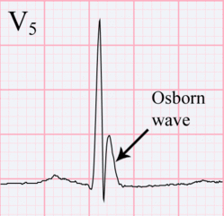
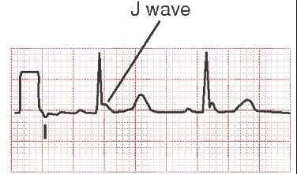
Hypothermia EKG
What is the typical EKG finding in hypothermia?
J wave or Osborn wave…what does it look like?
Usually not seen until around 32C

Slide 15
Hypothermia: Mechanism
During the first hour after induction of anesthesia core body temperature drops by 1.5C because of what?
A: The OR is so cold, so so cold, it is like Arendelle when Ilse started the eternal winter
B: Radiation heat loss from the patient to the air
C: Redistribution of body heat from core to periphery
D: Evaporative heat loss

Slide 16
Hypothermia: Mechanism
During the first hour after induction of anesthesia core body temperature drops by 1.5C because of what?
A: The OR is so cold, so so cold, it is like Arendelle when Ilse started the eternal winter
B: Radiation heat loss from the patient to the air
C: Redistribution of body heat from core to periphery
D: Evaporative heat loss

Slide 17
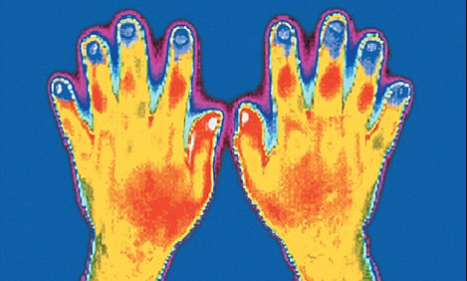
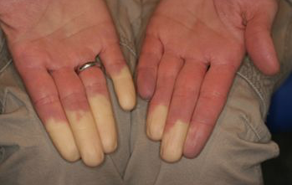
Redistribution
If the OR were 37C, what would the patient’s temperature be after one hour of GA?
35.5…why?
Redistribution causing core temperature to approach mean temp

Slide 18
Heat loss: Mechanisms
What are the 4 mechanisms of heat loss?
Radiation
Conduction
Evaporation
Convection
Which one plays the largest role in the OR?
Radiation, then convection
Magnitude of heat loss due to radiation is proportional to the difference in temp to what power?
4th

Slide 19
Mechanisms

Slide 21
Preventing Hypothermia
How can we prevent the 1.5C drop from redistribution in the first hour after induction of anesthesia?
Increase mean body temp…how?
Pre-warming—but requires 2 hours to be fully effective

Slide 22
Preventing/Treating hypothermia
Is it better to place a warmer on top of the patient or under the patient?
On top. Why?
Patient’s weight compresses the tissue on the warmer, less blood flow
What is the most effective non-invasive method of warming a patient?
Forced air warming

Slide 23
Preventing/Treating Hypothermia
What is the overall most effective method for warming a patient (invasive and non-invasive)?
Cardiopulmonary bypass
How warm should IV fluids be?
38-42C

Slide 24
Rewarming

Slide 25
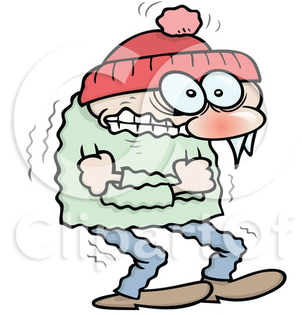
Shivering
When does shivering occur?
Core temp of 32-35C
How much can shivering increase core temp?
1.5C/hr
What are the downsides to shivering?
Increased metabolic demand, increased O2 consumption, increased ICP

Slide 26
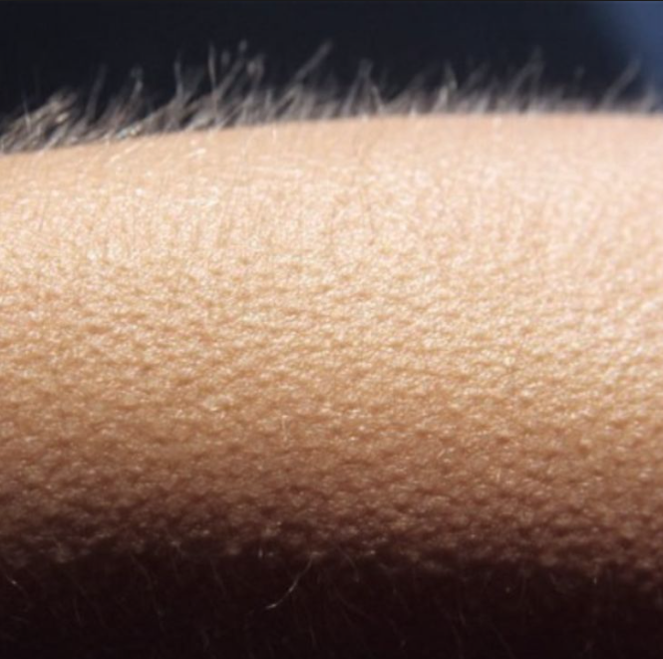
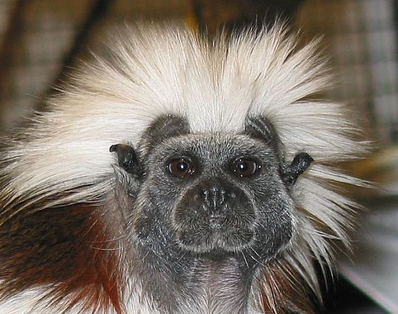
Piloerection
Why do goosebumps happen?
Trap air close to skin to create “warm layer”

Slide 27
Temperature regulating center
Where is the temperature regulating center in the human brain?
The hypothalamus---what part?
Preoptic area in anterior portion
From where does it receive signals?
Peripheral (skin, mucous membranes)
Central

Slide 28
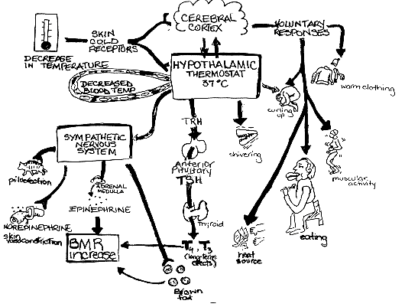
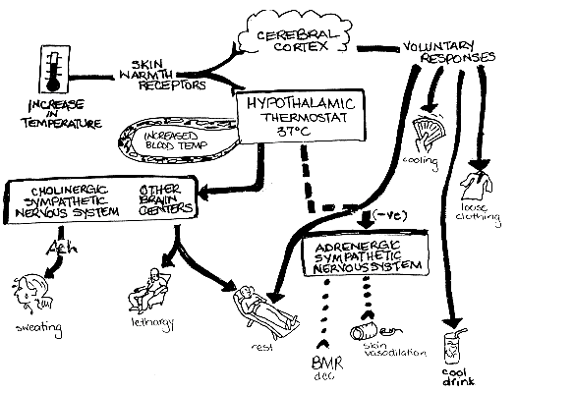
Temperature regulating center

Slide 29
Measurement sites
Where is the most accurate place to measure body temperature (closest to what the hypothalamus sees)?
A: Rectal
B: Bladder
C: Nasopharyngeal
D: Distal Esophageal
E: Axial

Slide 30
Measurement sites
Where is the most accurate place to measure body temperature (closest to what the hypothalamus sees)?
A: Rectal
B: Bladder
C: Nasopharyngeal
D: Distal Esophageal
E: Axial

Slide 31
Measurement sites
Where is the overall most accurate place to measure core body temp?
PA or high IJ
Rectal, bladder, oral, axillary, tympanic, temporal artery, all have mixed results
Nasopharyngeal is decent but carries bleeding risk

Slide 32
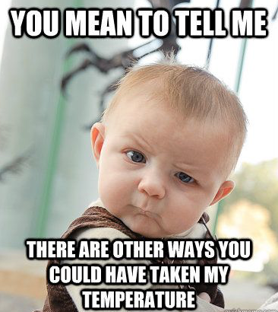
Measurement sites

Slide 33
Non-MH hyperthermia syndromes
Neuroleptic Malignant Syndrome: What is it?
Syndrome of rigidity, fever, AMS, autonomic instability caused by what?
Antipsychotics (up to 2% risk) or what else?
Reglan and what else?
Cessation of dopamine agonist (amantadine, bromocritine, levodopa)
Late onset (24-72h, up to 2 weeks)
What is the treatment?
Cessation of meds or restarting of stopped meds and…
Supportive care and…
Dantrolene (2-3mg/kg/day up to 10mg/kg/day)

Slide 34
Non-MH hyperthermia syndromes
Serotonin Syndrome—what is it?
Syndrome of AMS, fever, autonomic hyperactivity, neuromuscular abnormalities (hyperreflexia, clonus)
Caused by?
SSRI, MAOI, TCA, tryptophan, ritonavir, lithium, triptans, meperidine, fentanyl, methylene blue
How does it differ from NMS?
Abrupt onset, within 6 hours, hyperreflexia, clonus, less rigidity, dantrolene doesn’t help
Treatment?
Stop drug, supportive care, benzos
If severe can consider paralysis

Slide 35
Fever Facts
True or false, the severity of fever in hospitalized patients does not correlate with likelihood of infection
True
50% of fevers in ICU are not related to infection and 67% in the post-op period are not from infection
True or false, treating fever below 40C may cause harm
True
There is a cycle to normal human temp. When is the hottest and coldest time of day?
Minimum 4-8am; maximum 4-6pm
The “normal” temp of 37C was derived from what?
Axillary temps taken in 1871

