Slide 1
IV Fluids
Jed Wolpaw MD, M.Ed

Slide 2
Based on primarily
Millers Anesthesia, 8th Edition
Myburgh JA and Mythen MG. Resuscitation Fluids. NEJM 2013; 369:1243-51.

Slide 3
History
1832 Robert Lewins treating patients during cholera epidemic
“Quantity needed will probably be dependent upon the amount of serum lost”
Paul Merik: Sepsis is not a hypovolemic state
Focus on de-escalation

Slide 4
Physiology
Water makes up about 60% of the body (varies by age, gender, body type)
Lean people 75%, Obese 45%
Age | TBW (%) | ECF (%) | Blood Volume (%)
Neonate | 80 | 45 | 9
6 mo | 70 | 35
1 yr | 60 | 28
5 yr | 65 | 25 | 8
Young adult (male) | 60 | 22 | 7
Young adult (female) | 50 | 20 | 7
Elderly | 50 | 20

Slide 5
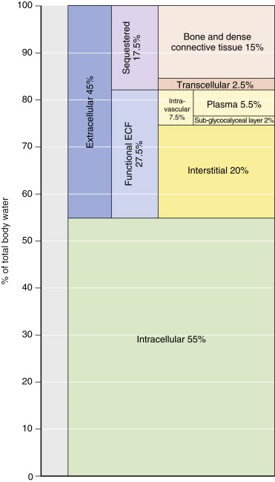
Physiology
ICF:ECF 2:1 excluding non-sequestered
Of non-sequestered extracellular about ¼ is intravascular
Sub-glycocalyceal layer holds onto some fluid that doesn’t dilute hgb but does support pressure
Damage to glycocalyx harms endothelial integrity: some evidence it is damaged by excessive fluid which causes release of cardiac natriuretic peptides which can damage glycocalyx (probably to get fluid out)

Slide 6
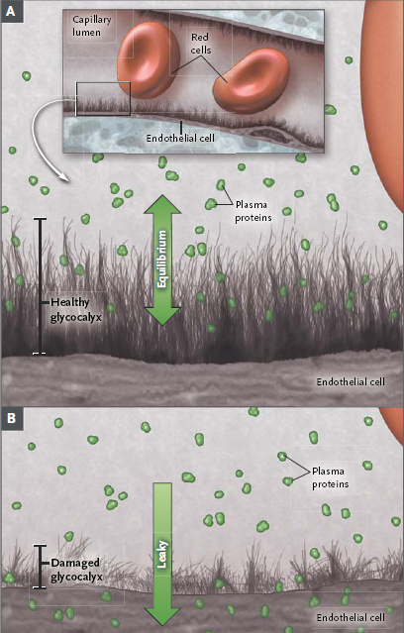
Glycocalyx
Myburgh JA and Mythen MG. Resuscitation Fluids.
NEJM 2013; 369:1243-51.

Slide 7
Fluid therapy
Loss of up to 25% of blood volume may not have any vital sign abnormalities
UOP often reduced post-op even in the presence of normal blood volume 2/2 ADH and RAA
CVP influenced by venous compliance which changes in low volume so can have normal or high CVP in hypovolemia
Very low CVP may be helpful
Using ml/kg approach leads to greater amounts of fluid given which leads to greater morbidity and mortality when more than 3500-5L given in periop period

Slide 8
Goal directed therapy
Using specific targets (CO, ABP, SV, etc) to tailor therapy to individual rather than giving a set ml/kg
Cochrane Review in 2012 found reduced mortality, hospital length of stay
Some may get more fluid (usually colloid) but it is targeted rather than indiscriminate use in studies of “liberal fluid strategy”
Multiple studies have shown an even fluid balance after initial resuscitation in Sepsis, Critical illness, leads to better outcomes
In ARDS the dryer the better
Giving fluid intraop for anesthetic induced hypotension makes no sense
Grocott M.P.W., Dushianthan A., Hamilton M.A., et al: Perioperative increase in global blood flow
to explicit defined goals and outcomes following surgery. Cochrane Database Syst Rev 2012; 11: pp. CD004082

Slide 9
Crystalloid vs. Colloid
1998 Cochrane Review showed increased mortality with albumin
2004 SAFE study, almost 7000 patients, no difference in mortality
Ratio of crystalloid to colloid 1.4:1, not expected 3:1
Cochrane Review 2012: No difference in ICU patients outcomes
Albumin worsens mortality in TBI-subgroup of SAFE
Albumin may be beneficial in severe sepsis-subgroup of SAFE
CRISTAL Trial JAMA 2013: ICU pts with hypovolemic shock, most w sepsis
No mortality benefit to Albumin over crystalloid at 28 days, maybe at 90 days
Perel P., and Roberts I.: Colloids versus crystalloids for fluid resuscitation in
critically ill patients. Cochrane Database Syst Rev 2012; 6: pp. CD000567

Slide 10
Hydroxy-Ethyl-Starches
Scandinavian trial NEJM 2012, 800 patients
Increased mortality with 6% HES
CHEST Trial, NEJM 2012, 7000 ICU patients
No difference in 90 day mortality, increased rates of renal replacement therapy
In UK all starch has been suspended
Neither trial showed difference in resuscitation endpoints, 1.3:1 ration of crystalloid:HES
Interfere with coagulation, can accumulate in tissues, pruritis

Slide 11
Crystalloid vs Crystalloid
NS vs Balanced solutions (LR, PL)
Normal Saline defined as 0.9% based on faulty experiments in 1882 by Hartog Hamburger, overestimated from true value of 0.6%
NS causes metabolic acidosis, associated with increased renal failure, post-op infections,

Slide 12
Special cases
Free flaps
Excess fluid is harmful and not a good way to treat hypotension, low dose pressors are safe
Hepatic resection
Hepatic veins are valveless, can get back bleeding
CVP<5 during resection led to improved outcomes

Slide 13
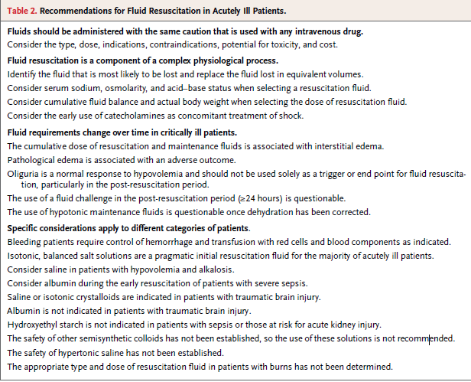
Recommendations
Myburgh JA and Mythen MG. Resuscitation Fluids.
NEJM 2013; 369:1243-51.

