Slide 1
Opioids part 1
Jed Wolpaw MD, M.Ed

Slide 2
Classification of opioids
Naturally Occurring
Morphine
Codeine
Papaverine
Thebaine
Semisynthetic
Heroin
Dihydromorphone, morphinone
Thebaine derivatives (e.g., etorphine, buprenorphine)
Synthetic
Morphinan series (e.g., levorphanol, butorphanol)
Diphenylpropylamine series (e.g., methadone)
Benzomorphan series (e.g., pentazocine)
Phenylpiperidine series (e.g., meperidine, fentanyl, sufentanil, alfentanil, remifentanil)
Miller’s Anesthesia 8th edition

Slide 3
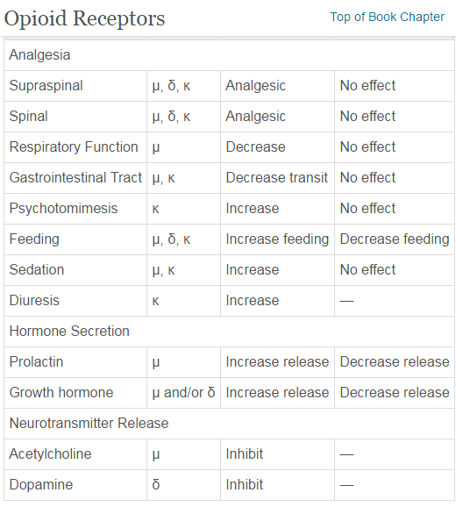
Receptors
G protein coupled, 3 types:
Mu, Delta, Kappa

Slide 4
Endogenous ligands
Delta: Enkephalin,
Mu: β-endorphin
Kappa: dynorphin

Slide 5
Mechanism of action
Activation of receptors leads to expression of G proteins
Inhibits Adenylate Cyclase→reduces cAMP
Causes reduction in voltage gated CA2+ channel and activation of inwardly rectifying K+ channel
Neuronal excitability is reduced
Leads to direct inhibition ascending transmission of pain signals from spinal cord dorsal horn and to activate pain modulating descending circuits from midbrain through medulla (rostral ventromedial medulla RVM) and PAG (periaqueductal gray) to dorsal horn

Slide 6
Mechanisms of mood alterations
Dopamine release in nucleus accumbens causes euphoria, “reward”
Inhibition of panic, fear, anxiety pathways in locus ceruleus

Slide 7
CNS effects of opioids
Analgesia, drowsiness, changes in mood, mental clouding, usually not loss of consciousness
Patients say pain is still present but they are more comfortable
Better for nociceptive pain (transmitted through intact neural structures) than neuropathic pain (damaged neural structures)

Slide 8
Effect on MAC
Fentanyl can reduce MAC of isoflurane by 80%, sevo by 60-75%
Interestingly, epidural fentanyl has more effect than intravenous
People wake up at higher concentrations of ISO when given IV fentanyl than when given epidural fentanyl at the same rate
Ceiling effect: after a certain dose won’t lower MAC any more
Also seen with EEG: won’t get a dose dependent reduction leading to flatline like you will with inhaled anesthetics

Slide 9
Evoked potentials
For neuromonitoring
Don’t effect sensory or motor evoked potentials
Do effect auditory evoked potentials

Slide 10
Cerebral blood flow/ICP
Usually cause small decreases in CMR and ICP or don’t affect them at all
Cause decreases in blood flow when combined with N20
Preserves CPP, mostly because of minimal effect on BP
Can cause neuroexcitation, high doses can cause seizures
Causes constriction of pupils through excitation of parasympathetic nerve to pupil

Slide 11
Opioid induced rigidity
Mechanism not fully understood
Not direct action on muscle fibers
Can be prevented or treated with nondepolarizing NMBs
Can also be prevented or treated with benzos such as versed

Slide 12
PRuritis
Not from histamine release (non-histamine releasing opioids still cause it)
Probably mediated by Mu receptor
Reversed by naloxone
Reduced by:
Zofran
Kappa agonists (pentazocine)
Droperidol
Propofol
Gabapentin

Slide 13
Respiratory effects: Beneficial
Prevent coughing except rapid bolus admin can cause cough
Depress upper airway, tracheal and lower respiratory tract reflexes
Prevent “bucking and coughing” with intubation when given 3-5 minutes before intubation and at doses of 3-5mcg/kg
Fentanyl has some antimuscarinic and antihistaminergic properties, may help bronchospasm

Slide 14
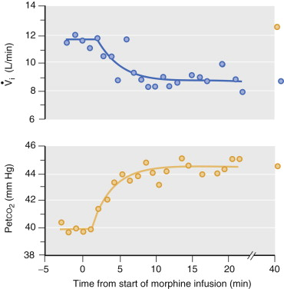
Respiratory effects: Harmful
Decrease response to hypercapnia and hypoxia through Mu receptor action in brainstem respiratory center
Apnea comes before unconsciousness
Pts will breathe if told to
Fentanyl cumulative doses above 20mcg/kg are predictive of need for post-op ventilation
Can depress drive to breath for many hours
Delayed/recurring respiratory depression
Increased release from muscle into plasma with rewarming, shivering, motion etc.
Miller’s Anesthesia 8th edition

Slide 15
Factors affecting respiratory depression
Dose
Older age
Other CNS depressants
Renal insufficiency
Hypocapnia
Reduction of hepatic blood flow—decreased clearance

Slide 16
Cardiovascular effects
Hemodynamically stable unless dependent on high sympathetic tone
Most cause bradycardia through central vagal nucleus except meperidine which can cause tachycardia
Bradycardia can be exacerbated with concomitant use of B-blockers or CA2+ channel blockers
Fentanyl, but not morphine, may have mild positive inotropic effects
Can provide effect similar to ischemic preconditioning: protect myocardium, reduce infarct size
Maintains O2 supply/demand ratio
Enhances oculocardiac reflex
Morphine and meperidine cause histamine release→hypotension via vasodilation

Slide 17
Endocrine effects
Reduce stress response by inhibiting HPA axis
Morphine and fentanyl prevent ACTH release and cortisol secretion
Can reduce surgically induced hyperglycemia

Slide 18
Tolerance and Hyperalgesia
Tolerance develops from long term use but also can happen with high dose short term remifentanil (0.3mcg/kg/min)
Prevented or attenuated by use of NMDA blockers: ketamine, N20, methadone, Mg2+
Zofran and propofol may also attenuate opioid induced hyperalgesia
Tolerance leads to lower pain threshold and hyperalgesia

Slide 19
Other effects
Urinary retention
Nausea, vomiting, inhibited gastric emptying, ileus
Nausea/vomiting can be attenuated by propofol, Zofran, decadron, low dose naloxone infusion (0.25 mcg/kg/HOUR) (doesn’t affect analgesia)
Sphincter of Oddi spasm is not real, mildly increases biliary duct pressure
Minimal to no effects on liver function
Cross placenta, can cause neonatal depression but not teratogenesis
Can attenuate increases in ICP from intubation and from sux

Slide 20
Immunity and Cancer
Suppress natural killer (NK) cells
Associated with greater rate of cancer recurrence
Likely through immunosuppression and direct effects on cancer cells
Cancer ERAS pathways try to limit or eliminate opioids

