Slide 1
HYPEROXIA
Jed Wolpaw, MD, M.Ed

Slide 2
Outline
History of Hyperoxia
Benefits of Hyperoxia: SSI?
Risks of Hyperoxia
ROS
Post-Cardiac Arrest
Post-MI
Stroke
TBI
Lung Injury
COPD
Intraoperative
Summary

Slide 3
Neonates: Not going to cover in detail
Now well established that excess O2 causes harm
Retinopathy of prematurity
Bronchopulmonary dysplasia
Gas of choice for neonatal resuscitation is room air
Antioxidant mechanisms in lungs don’t develop until late gestation
Preterm infants at high risk for damage
Yee et al, Am J Resp Cell Mol Biol 2013
Notes:
Antioxidant mechanisms don’t develop in lungs until end of gestation so adds to argument for ROS causing damage

Slide 4
Question
What were the average PaO2 and %O2 sat amongst 7 physicians breathing ambient air atop Mt. Everest?
A: 24.6 and 54%
B: O and O, they were Hopkins surgery residents and thus needed no petty comforts like oxygen for survival
C: 39.4 and 68.3%
D: 11.8 and 27.5%

Slide 5
Question
What were the average PaO2 and %O2 sat amongst 7 physicians breathing ambient air atop Mt. Everest?
A: 24.6 and 54%
B: O and O, they were Hopkins surgery residents and thus needed no petty comforts like oxygen for survival
C: 39.4 and 68.3%
D: 11.8 and 27.5%

Slide 6
How was heart surgery done on infants prior to bypass?
Hyperbaric chamber
Allowed paO2 in thousands
Could stop heart for a few minutes without tissue ischemia

Slide 7
What is the Cunningham Ball?
A: An annual dance for very intelligent pigs
B: A hyperbaric chamber the size of a hospital
C: A biennial gala held by the Society for Hyperbaric Medicine
D: The new term for an underinflated football named after the New England Patriot’s Ball Boy Greg Cunningham

Slide 8
What is the Cunningham Ball?
A: An annual dance for very intelligent pigs
B: A hyperbaric chamber the size of a hospital
C: A biennial gala held by the Society for Hyperbaric Medicine
D: The new term for an underinflated football named after the New England Patriot’s Ball Boy Greg Cunningham

Slide 9
The Cunningham Ball
Notes:
Dr. in charge was Dr. Cunningham. Compressed air at 2 atm, so 42% O2. Thought it would help cure diseases thought to be 2/2 anaerobic bacteria such as pernicious anemia, diabetes, some cancers. 64 feet in diameter and 5 stories tall

Slide 10
Surgical Site Infection?
JAMA 2004: RCT 165 pts undergoing abdominal surgery
Randomized to 80% or 35% Oxygen during surgery and first two hours after
100% allowed during induction and emergence or if SaO2 fell below 94%
Increase in SSI in group receiving 80% (25% vs 11.3% p=0.02)
Criticism: Groups differed in intraop blood loss, post-op fluid replacement, rates of obesity, study stopped early
Pryor, et al, JAMA 2004

Slide 11
Surgical Site Infection Meta-analysis
Excluding largest study (1000 pts per arm, more than other 4 combined)
Qadan et al, Archives of Surgery 2009

Slide 12
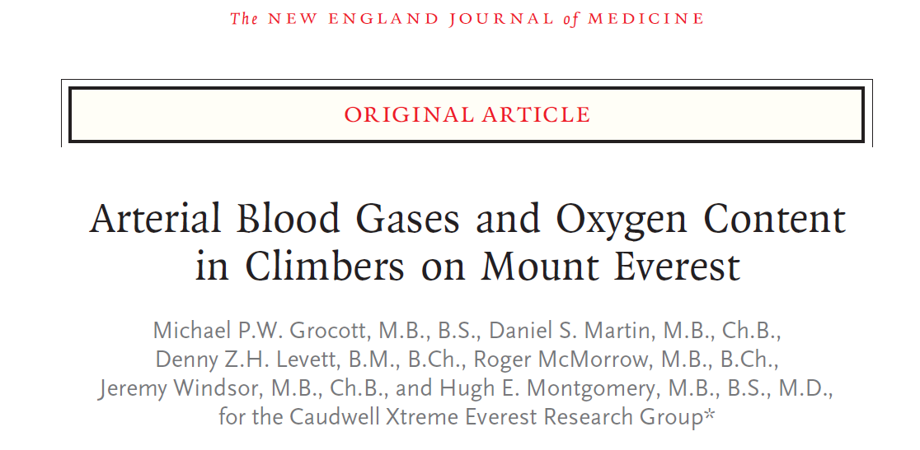
Some Thoughts
Evolved adaptations: Hypoxia vs. hyperoxia
How low is too low?
Average PaO2 24.6 (19.1-29.5); SaO2 54% (34.4-69.7); PCO2 13.3 (10.3-15.7)
Grocott, et al, NEJM 2009
Notes:
Average Hgb 19.3 (18.7-20.2). Barometric pressure 272 (.36 times normal atomspheric pressure)

Slide 13
Current Practice
Post-MI, post-arrest, post-stroke pts typically get supplemental O2 regardless of SaO2 or PaO2
Suzuki, J Crit Care 2013
51 patients over 358 ICU mechanically ventilated days
Most patients (59%) had SaO2>98% w PaO2 80-120
26% patients had PaO2>120 and 4% >202
Only 1% of patients had FiO2 0.21-0.29
Clinicians were more concerned with FiO2 than PaO2
Almost no adjustments were made regardless of how high the PaO2 was if the FiO2 was 0.3-0.5
Damiani et al, Crit Care 2014; Suzuki, et al, J Crit Care 2013

Slide 14
Data Caveat
Almost all of the data are from Observational studies
Lack of RCTs comparing two different SaO2 or PaO2 levels
Different studies use different definitions of hyperoxia and measure it at different times
Damiani et al, CCM 2014

Slide 15
Outline
History of Hyperoxia
Benefits of Hyperoxia
Risks of Hyperoxia
ROS
Post-Cardiac Arrest
Post-MI
Stroke
TBI
Lung Injury
COPD
Intraoperative
Summary

Slide 16
Reactive Oxygen Species
Examples of ROS
Superoxide
Hydrogen Peroxide
Peroxynitrite
Hydroxyl radical
Some serve important roles but in excess can:
Interact with and damage DNA, lipids, proteins, carbohydrates
Concentration of ROS in exhaled gas increases after 1 hour of breathing 28% O2
Brown and Griendling, Circ Res 2015

Slide 17
Reactive Oxygen Species
Brown and Griendling, Circ Res 2015

Slide 18
Hyperoxic Hypocapnia
ROS are thought to account for some of increased ventilation seen with increasing levels of O2
ROS may act at respiratory centers in brainstem
Causes reduction in PaCO2
Brown and Griendling, Circ Res 2015

Slide 19
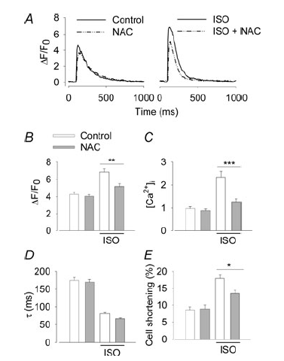
ROS Benefits
Known to play role in defense against pathogens and phagocytosis
Emerging evidence that ROS play an important role in other pathways
Isoproterenol induced increases in calcium flux and contractility were attenuated by NAC
B-adrenergic activation caused increase in ROS
Prolonged activation (>24h) caused cell death
Excess ROS production caused opposite results
ROS in limited amounts play important role
Andersson et al, J Phys 2011
Notes:
Delta F/Fo is calcium flux. Also play a role in cellular defense and phagocytosis

Slide 20
Outline
History of Hyperoxia
Benefits of Hyperoxia
Risks of Hyperoxia
ROS
Post-Cardiac Arrest
Post-MI
Stroke
TBI
Lung Injury
COPD
Intraoperative
Summary

Slide 21
Two hit model
Ball and Ranzani, Intensive Care Medicine Jan 2015
First hit: Hypoxic ischemic injury from cardiac arrest
Second hit: Reperfusion injury made worse by:
Hyperoxic vasoconstriction (Hypocapnia and ROS scavenging NO)
Increased susceptibility to ROS (increased ROS from hyperoxia)
Ball and Ranzani, Int Care Med 2015

Slide 22
Hyperoxic Hypocapnia
Mechanism not fully understood
Initial brief hypoventilation followed by hyperventilation
Possible mechanisms
O2 induced vasoconstriction in brain leading to reduced blood flow and subsequent hyperventilation
Reverse Haldane effect: Increased O2 causes reduced binding of CO2 to Hgb in tissues (and respiratory center) leading to locally increased PaCO2 and hyperventilation
Sjoberg et al, J Int Med 2013
Notes:
This is an important concept so I want to revisit it. The last point emphasizes that high O2 impact on cerebral blood flow may be largely due to associated hypocapnia

Slide 23
Restrospective Review
184 pts over 2 year period (2008-2010) with cardiac arrest who survived at least 24h (60% PEA, 40% VT/VF; 60% out of hospital)
36% exposed to severe hyperoxia (PaO2>300)
Adjusted OR for reduced survival per hour of exposure in this group was 0.83 (0.69-0.99) p=0.04
No difference in neurologic outcomes
Several limitations: retrospective, no data on important comorbidities, LOS, epi dose
Elmer et al, Int Care Med 2015

Slide 24
Elmer Review graphs
Note, this is after ROSC. They all got 100% O2 during CPR
Elmer et al, Int Care Med 2015

Slide 25
RCT 30% vs. 100% for post-ROSC
Pilot study, not powered for outcomes
14 pts in each arm
30% vs. 100% O2 for 60 minutes post-ROSC
Measured serum markers of neuronal injury (NSE and S-100), adequacy of oxygenation and need to increase FiO2 in 30% group
Found trend toward increased serum markers in 100% group (statistically significant when looking only at pts not getting hypothermia)
No hypoxemia in 30% group
Kuisma et al, Resuscitation 2006

Slide 26
Kilgannon JAMA 2010
Database of 120 US ICUs from 2001-2005
Non-traumatic cardiac arrest w CPR within 24h of ICU arrival
3 groups based on first ABG w hypoxic PaO2<60 (or p/f ratio <300), normoxic 60-299 and hyperoxic >300
6326 pts, 18% hyperoxic, 63% hypoxic
Mortality hyperoxic 63%, hypoxic 57%, normoxic 45%
Limitations: Observational only (association, not causation), No data on actual resuscitation (duration, etc.), no data on who got hypothermic treatment
Take away: Hypoxia and hyperoxia are probably both bad
Kilgannon et al, JAMA 2010
Notes:
But important to note here that hypoxia is also bad

Slide 27
Kilgannon survival curve
Kilgannon et al, JAMA 2010

Slide 28
Damiani Meta Analysis Post-cardiac arrest
Hyperoxia defined as PaO2>300
Damiani et al, Crit Care 2014

Slide 29
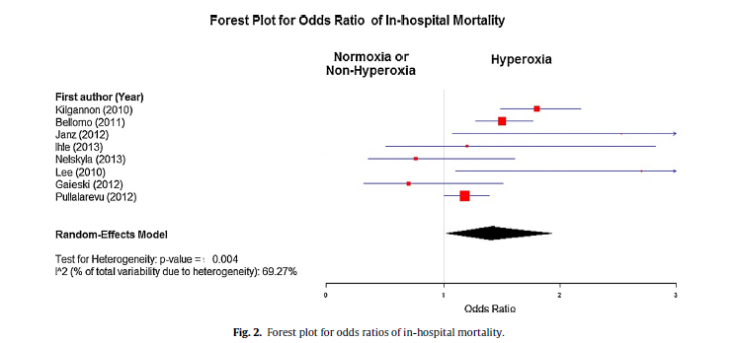
Wang Meta Analysis
14 Studies, large heterogeneity
OR for death was 1.4 (1.02-1.93) I^2=69%. Hyperoxia defined as PaO2>300
Wang et al, Resuscitation 2014

Slide 30
Outline
History of Hyperoxia
Benefits of Hyperoxia
Risks of Hyperoxia
ROS
Post-Cardiac Arrest
Post-MI
Stroke
TBI
Lung Injury
COPD
Intraoperative
Summary

Slide 31
Cardiac Ischemia and O2 history
1950 Russek et al reported supplemental o2 failed to reduce ECG signs of ischemia or reduce angina
1969 Bourassa et al proposed that the decreased blood flow from hyperoxia may cause ischemia
1976 RCT Rawls and Kenmure showed increased cardiac markers in acute MI pts getting high flow o2 vs room air
Also trend toward tripled death rate.
Iscoe et al, Critical Care 2011

Slide 32
Downside of O2 for ischemic hearts
Recommendations and Guidelines have traditionally called for O2 to be administered regardless of PaO2 or SaO2 (MONA)
However, emerging evidence suggests it may:
Reduce coronary blood flow
Reduce stroke volume and cardiac output
Increase SVR
Increase reperfusion injury
Sjoberg et al, J Int Med 2013

Slide 33
Reduced O2 delivery
Increasing PaO2 from 100 to 600 increases content by only 15ml/L or about 7-8%
Hyperoxia decreases cerebral blood flow by 11-33% and coronary flow by 8-29%
Net decrease in delivery may be cause of worse outcomes
Theory that hyperbaric O2 may be able to overcome this but data is lacking
Iscoe et al, Critical Care 2011

Slide 34
Cochrane Review 2010
Looked for RCTs of NSTEMI or STEMI comparing air with O2
Found 4 trials, 430 pts, 17 deaths, pooled RR for death was 2.11 (0.78-5.68)
Cabello et al, Cochrane Collaboration 2010

Slide 35
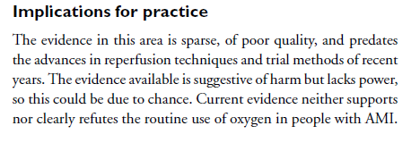
Cochrane Review 2010
Cabello et al, Cochrane Collaboration 2010
Notes:
But we give it routinely

Slide 36
Ongoing Trial
AVOID study, Australia, Multicenter RCT, enrolling 490 pts w STEMI without hypoxia
Randomized to room air vs supplemental O2
Primary outcome is infarct size
Stub et al, Am Heart Journal 2012

Slide 37
Outline
History of Hyperoxia
Benefits of Hyperoxia
Risks of Hyperoxia
ROS
Post-Cardiac Arrest
Post-MI
Stroke
TBI
Lung Injury
COPD
Intraoperative
Summary

Slide 38
Endothelial dysfunction
Hyperoxia is efficacious in non-clinical studies but this has not translated clinically
Knockout mice designed to mimic endothelial dysfunction found in acute stroke
Normal mice: hyperoxia improved tissue perfusion
Knockouts: Hyperoxia worsened perfusion
One knockout model was nitric oxide synthase
Suggests that inadequate NO may place pts at increased vulnerability to ROS from hyperoxia
Shin et al, J Neuroscience 2014

Slide 39
Post-stroke mortality
Restrospective multicenter cohort study 2894 pts
Acute ischemic stroke, SAH and ICH in 84 ICUs
Hyperoxia (PaO2>300), Hypoxia (PaO2<60) and Normoxia
Crude OR for hyperoxia 1.7 (1.3-2.1 p<0.0001) and for hypoxia 1.3 (1.1-1.7 p=0.01)
Adjusted OR for hyperoxia 1.2 (1.04-1.5)
Limitations: Retrospective, observational, lacking data on disease severity
Rincon et al, Crit Care Med 2014

Slide 40
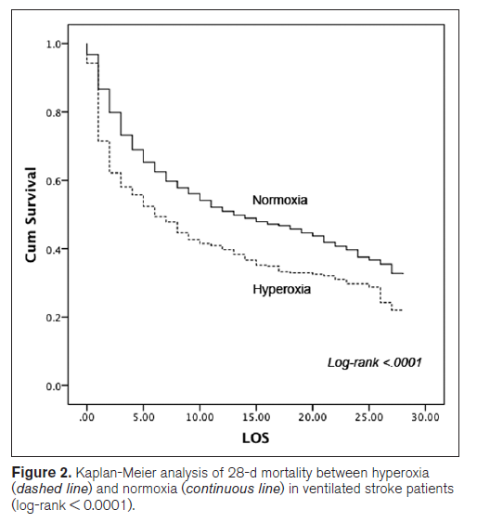
Post-stroke mortality
Rincon et al, Crit Care Med 2014

Slide 41
Stroke Meta Analysis
Hyperoxia defined as PaO2>300
Damiani et al, Crit Care 2014

Slide 42
Outline
History of Hyperoxia
Benefits of Hyperoxia
Risks of Hyperoxia
ROS
Post-Cardiac Arrest
Post-MI
Stroke
TBI
Lung Injury
COPD
Intraoperative
Summary

Slide 43
Hyperoxia in TBI
Retrospective multicenter cohort study of 1212 pts in 61 ICUs
Divided into hyperoxia (PaO2>300), hypoxia (PaO2<60) and Normoxia
21% were hyperoxic (of these half had PaO2>400), 46% were hypoxic
Adjusted OR for death in hyperoxia group was 1.5 (1.02-2.4) p=0.04
Proposed mechanism is 11-33% decrease in cerebral blood flow with hyperoxia, maybe worse with endothelial dysfunction
Rincon et al, J Neurol, Neurosurg, Psychiatry 2014

Slide 44
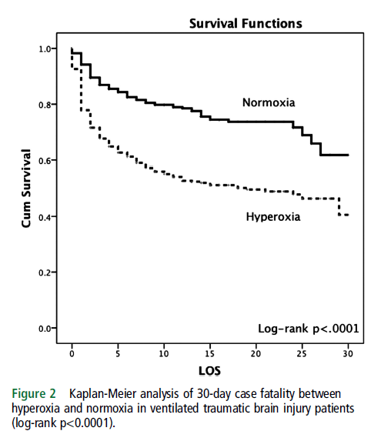
Hyperoxia in TBI
Rincon et al, J Neurol, Neurosurg, Psychiatry 2014

Slide 45
Excitotoxicity in TBI
Retrospective analysis of 1130 TBI patients monitored with cerebral microdialysis (CMD) and and brain tissue oxygenation (PbtO2)
Increased FiO2 is common way to treat decreased PbtO2 in TBI but recent data suggests it may cause harm
Increased exctracellular glutamate increases excitotoxicity of brain tissue and cell death
In culture astrocytes exposed to high FiO2 had reduced ability to protect other cells from glutamate
CMD allows measurement of extracellular glutamate
Quintard, Neuro Crit Care 2014

Slide 46
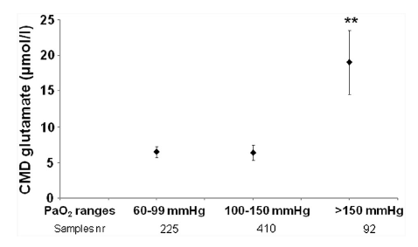
Excitotoxicity in TBI
Levels of glutamate greater than 10 umol/l have been shown to correlate with worse neurologic outcome after TBI
Quintard, Neuro Crit Care 2014
Notes:
One asterisk is p<0.05, two is <0.01

Slide 47
TBI Meta Analysis
Damiani et al, Crit Care 2014

Slide 48
Outline
History of Hyperoxia
Benefits of Hyperoxia
Risks of Hyperoxia
ROS
Post-Cardiac Arrest
Post-MI
Stroke
TBI
Lung Injury
COPD
Intraoperative
Summary

Slide 49
Pulmonary toxicity history
1775 Joseph Priestly: “Though pure dephlogisticated air might be very useful as a medicine, it might not be proper for us in the usual healthy state to the body.”
1899 Lorrain-Smith exposed animals to 3 atm O2 and found their lungs to be severely damaged
Mid 1900’s new more efficient ventilators led to increasing pulmonary oxygen toxicity in humans
Ooij et al, Res Phys and Neurobiology 2013

Slide 50
Symptoms of oxygen toxicity
Mild substernal tickling, tracheal irritation
Chest tightness leading to increasing substernal pain and uncontrolled coughing
DOE and eventually dyspnea at rest
Ooij et al, Res Phys and Neurobiology 2013

Slide 51
Pathophysiologic changes
Denuded alveolar type 1 cells
Capillary cell edema
Squamus metaplasia of tracheal and bronchial mucosa
Eosinophilic slough within bronchioles
Formation of hyaline membranes
End stage of emphysematous destruction and/or fibrosis
Ooij et al, Res Phys and Neurobiology 2013

Slide 52
Clinical changes
Impaired mucociliary function leading to mucous plugging, atelectasis, secondary infection
Erythema and edema of large airways can be seen bronchoscopically after 6 hours at 90% O2
Concentration of ROS in exhaled gas can be seen after 1 hour breathing 28% O2
Absorptive atelectasis can cause 11% shunt in healthy people breathing 100% O2 for 30 minutes
Ooij et al, Res Phys and Neurobiology 2013

Slide 53
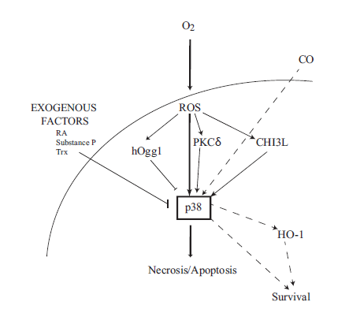
Cellular signaling pathways
Porzianato et al, Resp Phys and Neurobiology 2014

Slide 54
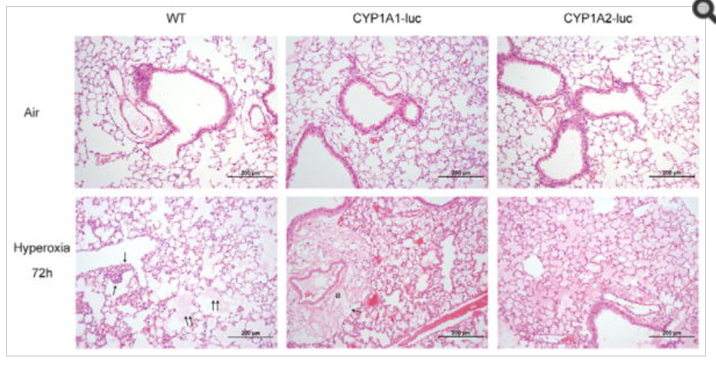
Murine Knockouts
Superoxide dismutase knockout mice die shortly after birth with extensive ROS injury in lungs, heart, brain
CYP1A 1 and 2 knockouts show severe damage in response to hyperoxia
Jiang et al, Biochem Biophys 2012
Notes:
Normal across top, hyperoxia on bottom with wild type and 2 knockouts of CYP enzymes that control production of antioxidants downstream. First inflammatory cells and beginning edema, then worse edema and widening of pulm artery. Finally proteinaceous material filling alveoli

Slide 55
Pathophysiologic changes
Ooij et al, Res Phys and Neurobiology 2013
Notes:
Looks a lot like ARDS

Slide 56
Measuring pulmonary toxicity
Unit of Pulmonary Toxicity Dose: t is duration of exposure and PO2 is inhaled concentration of O2
Used by Divers worldwide to calculate exposure
Correlates to decrease in FVC
Ooij et al, Res Phys and Neurobiology 2013
Notes:
Looks a lot like ARDS

Slide 57
Spirometry
FVC decreases
Likely first from tracheobronchitis causing pain with inspiration
Later due to pulmonary edema, thickened airway epithelium
FEV1, DLCO decrease, DLCO for days to weeks after exposure in some people
Pulmonary compliance decreases
Early exudative phase: changes are reversible
Late proliferative phase: changes can be permanent
Ooij et al, Res Phys and Neurobiology 2013

Slide 58
Special cases
Patients with pre-existing injury from Bleomycin, Amiodarone and external beam radiation
At higher risk of developing diffuse alveolar damage
Likely secondary to a preexisting “First hit” as Bleomycin damages DNA and prevents lung’s ability to heal from oxidative damage
Neonatal exposure to hyperoxia places mice at increased risk of severe bleomycin and influenza damage to lungs
Yee et al, Am J Resp Cell Mol Biol 2013

Slide 59
Outline
History of Hyperoxia
Benefits of Hyperoxia
Risks of Hyperoxia
ROS
Post-Cardiac Arrest
Post-MI
Stroke
TBI
Lung Injury
COPD
Intraoperative
Summary

Slide 60
COPD high flow vs titrated O2
405 Patients in Australia who called EMS for COPD exacerbation
Randomized to high flow O2 (10L NRB face mask) vs. titrated O2 to keep sats 88-92%
For all patients RR of death was 0.42 w titrated O2 (0.2-0.89 p=0.02)
For confirmed COPD RR was 0.22 (0.05-0.91 p=0.04)
Titrated O2 group less likely to have respiratory acidosis or hypercapnia
NNH 14 (for every 14 pts given high flow, one will die)
Austin et al, BMJ 2010
Notes:
This was in-hospital mortality. 70% of deaths were within first 5 days. No one died before arrival to hospital.

Slide 61
COPD high flow vs titrated O2
Found many providers gave higher flow O2 than dictated because of “ingrained habit”
Effect may have been larger if less of this crossover
Guidelines in Britain and U.S.A. now suggest titrated O2 rather than high flow in COPD
Austin et al, BMJ 2010

Slide 62
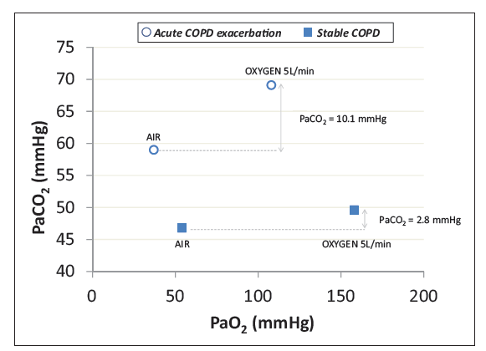
Hyperoxia and acidosis in COPD
In a study of 980 pts in ED w COPD exacerbation
20% had respiratory acidosis
Strong correlation with PaO2
Presence of respiratory acidosis was associated with 12.1% risk of death compared to 6.9% without
Lellouche et al, Can Resp Journ 2013

Slide 63
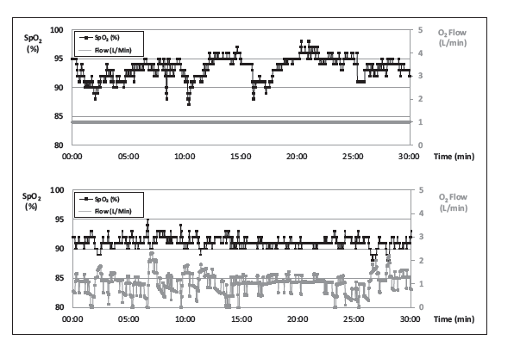
Closed loop O2 delivery for COPD
Uses SaO2 to provide continuous feedback and allows continuous adjustment of FiO2 to maintain a programmed SaO2
3 systems have been developed, being tested currently
Lellouche et al, Can Resp Journ 2013

Slide 64
Closed loop O2 delivery for COPD
Lellouche et al, Can Resp Journ 2013
Notes:
Arrows are where patient had to stop exercising. Goal was sat 91%. Early data suggests these devices may lead to earlier discharge.

Slide 65
Outline
History of Hyperoxia
Benefits of Hyperoxia
Risks of Hyperoxia
ROS
Post-Cardiac Arrest
Post-MI
Stroke
TBI
Lung Injury
COPD
Intraoperative
Summary

Slide 66
Time to desaturation
Lumb and Walton, Anesthesiology 2012

Slide 67
One Lung Ventilation
Lung collapses faster with 100% O2 than with air
Still faster with N2O
Most useful with bronchial blockers
High risk for lung injury with stress on single lung and typically high FiO2
Recommendations are to start with 80% and titrate down to maintain SaO2 90-92%
Non-ventilated long gets hypoxic and is very vulnerable to reperfusion injury exacerbated by high FiO2
Lumb and Walton, Anesthesiology 2012

Slide 68
PONV
Early studies showed decreased incidence of PONV with 80% vs. 30% FiO2
Subsequent studies have failed to replicate this
Meta Analysis 2008 A&A showed no benefit
Lumb and Walton, Anesthesiology 2012

Slide 69
Anesthetic outcomes in children
Kopp suggests that hyperoxia during anesthetics may play a role in the potential harm caused by repeated anesthetics in children under age 2
Suggests future studies should include a 21% FiO2 arm
Kopp, Anesthesiology 2009

Slide 70
Overall Intraop
Risk for lung injury, atelectasis, decreasing lung volumes, airway irritation and postoperative pain, local tissue hypoxia, coronary vasoconstriction, cerebral vasoconstriction, etc.
No good data for reduced n/v, infection (except maybe in colon surgery)
Probably worthwhile for induction and possibly emergence
Otherwise, balance risk of losing the airway with the risks of high FiO2

Slide 71
Summary
Oxygen can be life-saving
It can also be harmful
Excess ROS
Vasoconstriction causing reduced local DO2
Hypocapnia
Direct tissue damage
We are not starting with an even playing field
Try not to reflexively give high flow O2 in traditional situations (Post-arrest, MI, stroke, TBI, COPD)
With some exceptions, titrate O2 to normoxia
More and better studies are needed

