Slide 1
restrictive Lung Disease
Jed Wolpaw MD, M.Ed

Slide 2
Restrictive pathology
Because of intrinsic (lung parenchyma) or extrinsic causes, lungs cannot expand easily
Is it easier to get air in or out?
Difficult to get air in, easy to get air out
What is the typical breathing pattern?
Rapid shallow breathing

Slide 3
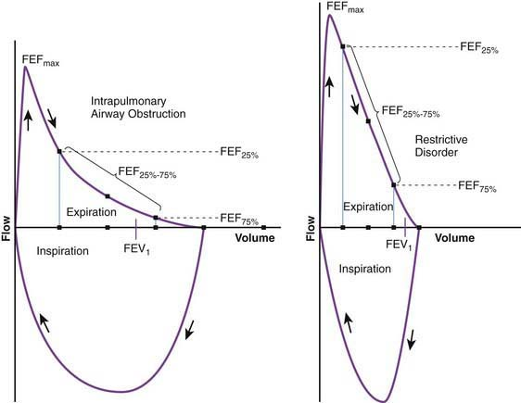
Restrictive loops

Slide 4
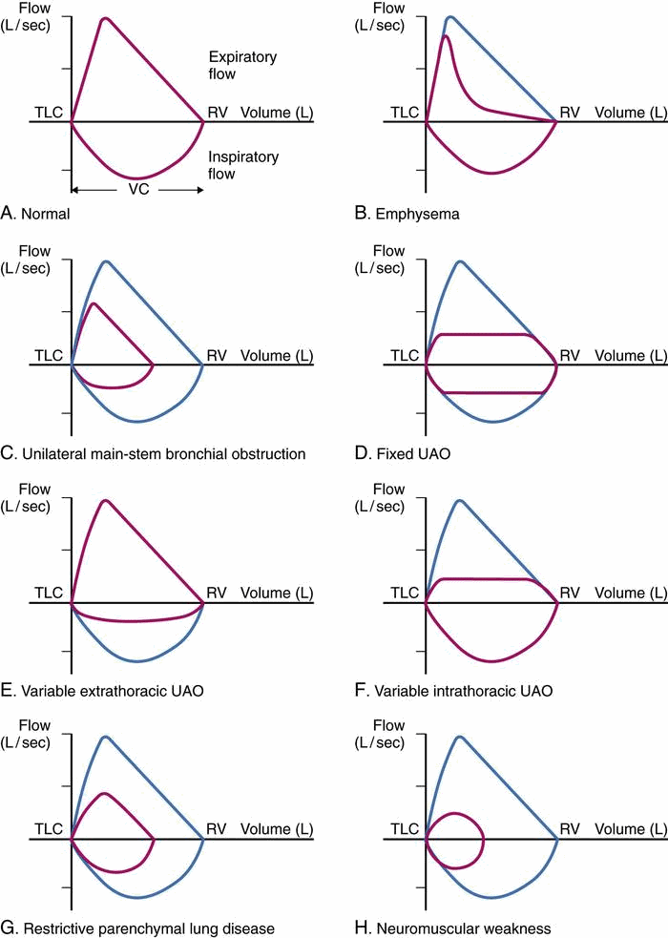
All the loops

Slide 5
What is the classic spirometric finding in restrictive lung disease?
A: increased total lung capacity
B: preserved or increased Fev1/fvc ratio
C: Siginificantly decreased fev1/fvc ratio
D: Increased dlco

Slide 6
What is the classic spirometric finding in restrictive lung disease?
A: increased total lung capacity
B: preserved or increased Fev1/fvc ratio
C: Siginificantly decreased fev1/fvc ratio
D: Increased dlco

Slide 7
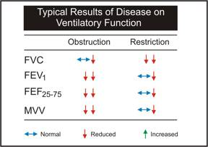
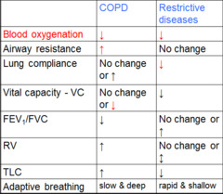
Spirometry

Slide 8
DLCO (Diffusion capacity for carbon monoxide)
Measures the ability of the lungs to transfer o2 to the blood
Restrictive disease (helps with ddx)
Reduced lung volumes with reduced DLCO suggests what?
Interstitial lung disease
Reduce lung volumes with normal dlco suggests what?
extrapulmonary cause such as…
Obesity, pleural effusion, neuromuscular weakness, scoliosis
Pulmonary vascular disease shows what?
normal volumes w reduced dlco

Slide 9
DLCO summarized
Dlco normal, restrictive pattern: extrapulmonary restriction
DLCO reduced, restrictive pattern: ILD
DLCO normal, obstructive pattern: asthma
Dlco reduced, obstructive pattern: COPD
DLCO reduced, no restriction or obstruction: pulm vascular disease

Slide 10
Neurologic
What are neruologic causes of restrictive lung pathology?
CNS Depression
Spinal Cord Dysfunction
Peripheral Nervous System

Slide 11
Neurologic causes
What causes the restriction?
Lung parenchyma would expand fully but aren’t being “told to” (central) or can’t get signal (spinal/peripheral)
This can be due to cNS, spinal or peripheral dysfunction
CNS: Central hypoventilation syndrome, MS
Spinal/peripheral: ALS, Myesthenia gravis, Guillain-Barre

Slide 12
What would differentiate neurologic restriction from parenchymal with positive pressure ventilation in the OR?
A: neurologic would have higher plateau pressures, parenchymal would have higher peak pressures
B: Parenchymal would have higher peak and plateau pressures
C: Neurologic would have higher peak and plateau pressures
D: They cannot be distinguished

Slide 13
What would differentiate neurologic restriction from parenchymal with positive pressure ventilation in the OR?
A: neurologic would have higher plateau pressures, parenchymal would have higher peak pressures
B: Parenchymal would have higher peak and plateau pressures
C: Neurologic would have higher peak and plateau pressures
D: They cannot be distinguished

Slide 14
Musculoskeletal causes
What is an example of a Muscular cause?
Muscular dystrophy
A Skeletal cause?
Scoliosis, pectus carinatum, pectus excavatum
Others?
Obesity
Chest trauma, burns

Slide 15
Pleural and mediastinal
What are some pleural and mediastinal causes?
Pneumo-, Hemo-, and Chylothorax
Pleural Effusion
Empyema
Bronchopleural Fistula
pleural thickening

Slide 16
Parenchymal
Name some parenchymal causes:
Atelectasis, Infant RDS, Pneumonia, Interstitial Pneumonitis, Pulmonary Fibrosis, Respiratory Distress Syndrome (ARDS), Bronchopulmonary Dysplasia
Anything that makes the lungs stiffer, less compliant, harder to expand
Less total volume, hard to get air in, but no obstruction to outflow

Slide 17
Infant RDS
Due to a lack of what?
Surfactant
AKA: Hyaline membrane disease, surfactant deficiency disorder
Usually premature infants but can be genetic or associated with infection
Affects 1% of newborns, leading cause of death in premies
50% of babies born 26-28 weeks and 25% born 29-31 weeks
Associated with diabetic mothers
Incidence reduced by giving what?
steroids to mothers in labor<34 weeks

Slide 18
Infant rds
Barrel chest
Air bronchograms
White out

Slide 19
ARDS
Precipitated by:
sepsis
trauma
Pneumonia
aspiration
transfusion

Slide 20
Pulmonary Fibrosis

Slide 21
Pulmonary fibrosis
What exposures can can lead to PF?
Asbestos, coal dust, etc
Radiation
What Medications?
amiodarone, bleomycin, methotrexate
Associated with what diseases?
rheumatoid arthritis, SLE, scleroderma, sarcoid
Associated with what infection?
TB
idiopathic

Slide 22
What is the most common cause of death other than disease progression in pulmonary fibrosis?
A: renal failure
B: Hypercarbic respiratory failure
C: Right heart failure from pulmonary hypertension
D: end stage liver disease from liver fibrosis

Slide 23
What is the most common cause of death other than disease progression in pulmonary fibrosis?
A: renal failure
B: Hypercarbic respiratory failure
C: Right heart failure from pulmonary hypertension
D: end stage liver disease from liver fibrosis

Slide 24
Pulmonary fibrosis
People die from:
Progression of fibrosis and inability to oxygenate
Pulmonary hypertension-->R heart failure
Pulmonary emboli
Bronchogenic carcinoma
Infection
Brett Ley, Harold R. Collard, and Talmadge E. King, Jr. "Clinical Course and Prediction of Survival in Idiopathic Pulmonary Fibrosis", American Journal of Respiratory and Critical Care Medicine, Vol. 183, No. 4 (2011), pp. 431-440.

Slide 25
Other causes of restrictive pathology
Pain
Abdominal distension, ascites
Diaphragmatic hernia, congenital or otherwise

