Slide 1
Management of Respiratory Diseases Part 1
Jed Wolpaw MD, M.Ed

Slide 2
Outline
Management of the Patient with Respiratory Disease
Initial Evaluation
Preop preparation
Intraoperative management (to be done in part 2)
Post-op management (to be done in part 2)
Special issues with thoracic surgery (OLV) (to be done in part 2)
Special issues with pneumonectomy (to be done in part 2)

Slide 3
Evaluation: H&P
Focus on what is baseline and are they at it
Look for evidence of active infection/exacerbation
Fever, increased sputum from baseline, tachypnea, wheezing, crackles
Postpone elective surgery in setting of exacerbation or infection
What tests to get:
Baseline room air sat
PFTs: will discuss later but not routinely unless thoracic surgery
ABG: In severe disease may help to get baseline
Basic labs: high dose b-agonists and/or steroids can affect electrolytes and glucose and WBC
CXR: Unlikely to change management outside of thoracic surgery in absence of symptoms

Slide 4
Preop optimization
Smoking cessation: to be discussed in a minute
Assessment of cardiac risk: lots of overlap, on oral boards see COPD as indicator of long smoking history and risk for CAD-to be discussed more in a minute
Continue inhalers including immediately preop
Consider stress dose steroids
Preop sedation: too much anxiety can lead to breath stacking, but be very careful of oversedation→hypercarbia→acidosis
Remember, oral boards usually better to be conservative, if you’re going to give it stress that you will have continuous monitoring
Theophylline should be d/c’d day before surgery→arrhythmias and neurotoxicity and small therapeutic window, periop meds can increase levels

Slide 5
Smoking cessation
Consequences of stopping
First 24-48h: reduced carboxyhemoglobin, improved oxygenation to tissues, beginning of increase in ciliary function, increased sputum production and increased reactivity of airways
1-4 weeks: more recovery of ciliary function, reduction in sputum volume, decreased reactivity of airways
4-12 weeks: reduced inflammation, clear morbidity and mortality benefit, improved wound healing, full recovery of ciliary function
Recommendation: Quit as far in advance as possible but quitting anytime is better than not quitting at all

Slide 6
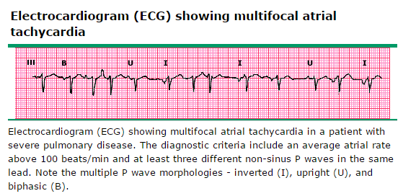
Cardiac Risk
Lung disease is risk factor for
Arrhythmias (MAT), pulm htn, coronary artery disease, CHF
Any patient having non-cardiac surgery should be assessed for risk of MACE (major adverse cardiac effect), see algorithm on next slide

Slide 7
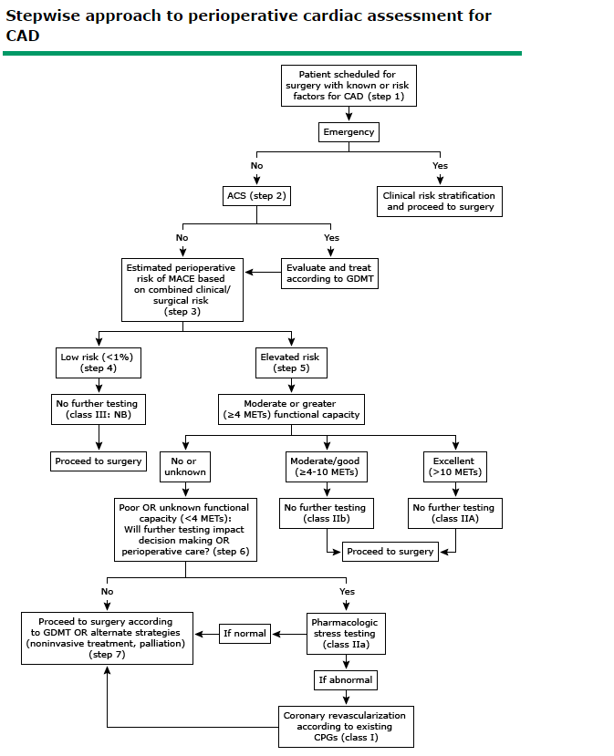
Fleisher LA, Fleischmann KE, Auerbach AD. 2014 ACC/AHA Guideline on Perioperative
Cardiovascular Evaluation and Management of Patients Undergoing Noncardiac Surgery:
A Report of the American College of Cardiology/American Heart Association Task Force on
Practice Guidelines. J Am Coll Cardiol 2014.

Slide 8
PFTs for Lung resection surgery
FEV1 and DLCO are most important
Preop FEV1 and DLCO>80% predicted are considered low risk even for pneumonectomy
For others, calculate predicted post-op
For lobectomies PPO FEV1 (or DLCO) = preop FEV1 x (1 – segments to be removed / total preop functional segments)
Normal = 10 segments in R lung and 8-10 in L
Remember, some of diseased lung may not be functioning so post-op fxn may be better than predicted
For pneumonectomies can do the same or use perfusion scanning
Ppo FEV1= Preop FEV1 x (1 – % of perfusion in lung to be resected)

Slide 9
PFTs for lung resection surgery
See algorithm for next steps but basically
If ppo FEV1 and DLCO are >60% predicted, good to go
If at least one is <60% but both >30% do stair test or shuttle test
If at least one <30% get formal exercise stress test w measurement of O2 consumption
Stairs>22m or shuttle walk >400 correlate w VO2 max>15ml/kg/min
V02 Max – most important predictor (others are surrogates)
If <10ml/kg/min extremely high risk of M&M, avoid surgery
If >20ml/kg/min can likely tolerate any resection including pneumonectomy
If 10-20, in between

Slide 10
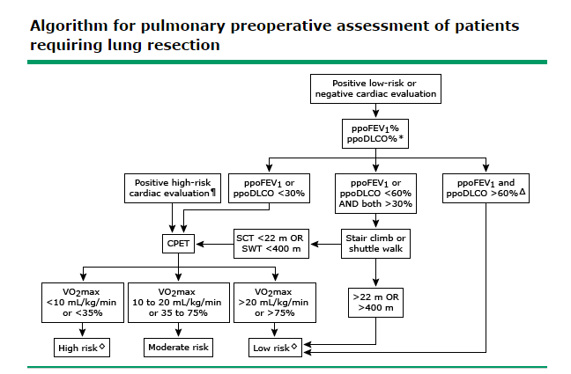
PFTs algorithm
Brunelli A, Kim AW, Berger KI, Addrizzo-Harris DJ. Physiologic evaluation of the patient with
lung cancer being considered for resectional surgery: Diagnosis and management of lung cancer,
3rd ed: American College of Chest Physicians evidence-based clinical practice guidelines.
Chest 2013;143:e166S. Illustration used with the permission of Elsevier Inc. All rights reserved.

Slide 11
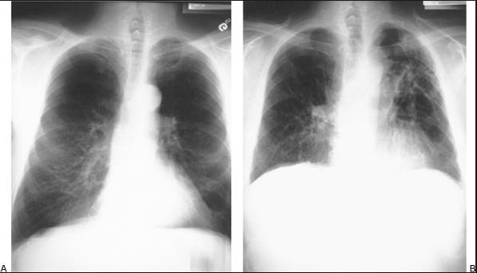
Lung volume reduction surgery (LVRS)
May be an option in poor candidates with severe emphysema
Can improve post-op lung function by getting rid of severely diseased lung and improving function of remaining “good” lung and diaphragmatic function
A: Before and B: 6 months after LVRS
Note improved diaphragmatic shape

