Slide 1
Management of Respiratory Diseases Part 2
Jed Wolpaw MD, M.Ed

Slide 2
Outline
Management of the Patient with Respiratory Disease
Initial Evaluation (done in part 1)
Preop preparation (done in part 1)
Intraoperative management
Post-op management
Special issues with thoracic surgery (OLV)
Special issues with pneumonectomy

Slide 3
Anesthetic management
Intraoperative Management
Monitoring
Choice of Anesthesia
Anesthetic Techniques: Nonpulmonary Surgery, Thoracic and Pulmonary Surgery, One-Lung Ventilation
Most of this is for patients with COPD. With restrictive lung disease main issues are hypoxia, rapid desaturations, high airway pressures, inability to extubate

Slide 4
Non-Thoracic surgery for patients with respiratory disease

Slide 5
Monitors
Standard
If severe disease will want a-line for ABG and likely concomitant cardiac disease
May be large gap between ETCO2 and PCO2

Slide 6
Concerns
Auto-peep/dynamic hyperinflation
Bronchospasm
Interference with hypoxic pulmonary vasoconstriction
Risk of PTX
Laparascopic surgery

Slide 7
The Lazarus syndrome

Slide 8
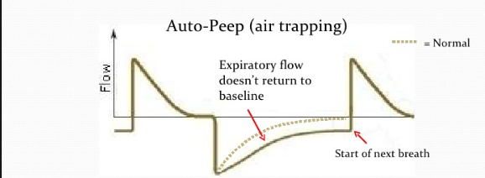
Flow time curve

Slide 9
Auto-peep/dynamic hyperinflation
Look at your ETCO2 curve, if sloped and not peaking, check flow time curve
Keep in mind for cause of hypotension, increased airway pressures
Increase I:E ratio and recheck flow time curves

Slide 10
Bronchspasm
Pre-existing hyper reactive airways
Risk for severe bronchospasm with intubation
Use lidocaine IV, consider spraying cords w lido, fentanyl (need much larger dose than we usually use to reliably block reflexes, 5mcg/kg or more), consider ketamine
Deep is better than light

Slide 11
Hypoxic pulmonary vasoconstriction
Patients with emphysema already have impaired HPV
Anesthesia makes it worse
Can lead to hypoxia, increasing dead space and gap between ETCO2 and PCO2, check ABG periodically

Slide 12
Risk of PTX
Patients may have bullae, can burst with positive pressure
Keep in mind for sudden hypotension, tachycardia, difficulty ventilating

Slide 13
Laparascopic surgery
Buildup of CO2 can be hard to deal with, can’t increase RR much because need to exhale
May need to ask surgeons for periodic desufflation to breathe off CO2
Already impaired diaphragmatic function can be worse with insufflation

Slide 14
Anesthetic technique
If possible avoiding intubation and maintaining spontaneous ventilation is good to decrease risk of bronchospasm, infection, prolonged intubation
Regional, epidural, spinal
Unless not possible (e.g. can’t lie flat, can’t stop coughing, very anxious, etc)

Slide 15
Sedatives
Caution with opiates and versed, especially in combination
Common oral board situation is bad COPD and bad anxiety in preop
TALK TO THE PATIENT

Slide 16
Neuraxial
If possible, use an epidural in COPD patients
Lower risk of post-op PNA and lower mortality
LINK to article:
http://www.ncbi.nlm.nih.gov/pubmed?term=21796055&holding=jhumlib&otool=jhumlib
Epidural analgesia is associated with improved health outcomes of surgical patients with
chronic obstructive pulmonary disease. Van Lier F, van der Geest PJ, Hoeks SE, van Gestel YR,
Hol JW, Sin DD, Stolker RJ, Poldermans D. Anesthesiology. 2011 Aug;115(2):315-21.

Slide 17
What about peripheral nerve blocks
Good idea with a caveats
Interscalene block and supraclavicular block have high risk of phrenic block
Paralyzes ipsilateral diaphragm—25% reduction in FVC
Worse on R side (more lung)

Slide 18
Induction
Consider ketamine
If major concern for bronchospasm consider inhaled induction
Etomidate can increase airway resistance

Slide 19
Maintenance
Inhaled anesthetics are bronchodilators (N20) is not
Propofol is not, but doesn’t harm
Caution with opioids
Lung protective ventilation but can’t go too high on RR
Avoid ongoing paralysis if possible to avoid post-op problems

Slide 20
POST-OP
Extubation
Pain Management
Respiratory Therapy

Slide 21
Extubation
Maximize chances of success
Complete reversal of NMB-use adductor pollicis rather than periorbital
Cautious use of opiates
Consider bronchodilators first
Give time to eliminate inhaled anesthetic, takes longer in COPD 2/2 VQ mismatch
Consider extubating to bipap
Criteria
Baseline oxygenation and ventilation
Usual criteria, but may be harder to meet

Slide 22
Pain management
Epidural, peripheral nerve catheter
multimodal: gabapentin, Tylenol, toradol if possible

Slide 23
Respiratory therapy
Goal is to prevent atelectasis, maintain lung expansion
Incentive spirometry
IPPV—no better than IS, more complications
Pulmonary toilet
Chest physio
Early mobilization: Reduces incidence of pulm complications, reduces hospital and ICU stay, improves mortality

Slide 24
Thoracic surgery
All of the above apply plus:
One lung ventilation
Double lumen vs bronchial blocker
Placement
Phsyiology
Dealing with hypoxia
Exchanging at the end of the case
Special considerations for pneumonectomy
Complications
Chest tubes
Mediastinoscopy
Compression of innominate
Reflex bradycardia

Slide 25
One lung ventilation
3 options
DLT
Bronchial blocker
Single lumen in a mainstem bronchus-rare
Advantages of DLT
Easy to insert, easy to suction, can intermittently ventilate both lungs
Advantages of bronchial blocker
Can isolate just part of a lung if necessary, no need to replace tube at end

Slide 26
How to place a DLT
Most common-Fiberoptically
Scope in bronchial lumen, find carina, orient yourself, place scope in desired mainstem (usually left) and then thread tube over scope
Then come out, go down tracheal lumen, find carina, go down R mainstem and look for RUL bronchus, then inflate bronchial cuff and see if it herniates out of carina
Go down bronchial side and make sure you are not occluding anything
Look at distance on tube when you think you are at carina with bronchial tip initially, if 28cm, probably not carina. If 12-22, probably fine
Distance from mouth to cords 8-10cm, from cords to carina about 10-14cm depending on height
If you are in at least 12-14cm you are not going to extubate

Slide 27
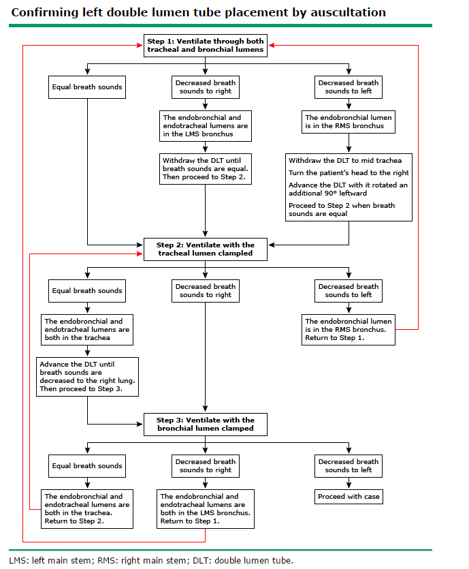
Confirming with auscultation
Oral board alert

Slide 28
Physiology of OLV
When supine, blood flow is 55% R lung, 45% L lung
When R side down it is 75% R lung
When L side down it is 70% L lung
Hypoxic pulmonary vasoconstriction increases this to 85-90% for R lung and 80-85% for Left lung

Slide 29
Hypoxia
Should not start at 100% FIO2, see podcast episode 3
If hypoxic, increase FIO2
If still hypoxic at 100%:
PEEP to ventilated lung (but can make it worse)
CPAP to non-ventilated lung if possible
Resume two-lung ventilation of necessary and possible
Last resort: clamp pulmonary artery

Slide 30
End of case ETT
Options are:
Extubate
Leave DLT in place (but most ICUs won’t accept this)
Extubate over an exchanger and reintubate with single lumen
Extubate completely and reintubate with single lumen: If easy airway
Can place laryngoscope or video laryngoscope, visualize cords, and keep view while removing DLT and replacing with SLT

Slide 31
Pneumonectomy complications
Arryhthmias: 25% of patients
Usually afib
PE: up to 7%, usually from LE but can be from pulm artery stump, more common on R
Intracardiac shunting: from either elevated RH pressure or change in cardiac geometry w IVC flow directed at PFO
Dyspnea, platypnea (SOB worse standing, better lying)
Cardiac herniation
Through defect in pericardium with torsion of heart
Hypotension, shock, chest pain, SVC syndrome
Lactation: From irritation of anterior thoracic nerves

Slide 32
Chest tubes
A chest tube placed to suction causes increased risk for cardiac herniation
Can use chest tube without suction
Some surgeons don’t use chest tubes at all
Special chest tubes that don’t allow suction

Slide 33
Mediastinoscopy
Can compress innominate artery leading to “apparent cardiac arrest” if monitors are on R arm. Can also cause cerebral ischemia
Put pulse ox and a-line on R and non-invasive cuff on left to identify compression and warn surgeon
Can also get reflex bradycardia from compression of trachea, vagus nerve, great vessels
Sudden hypotension could also be massive hemorrhage

