Slide 1
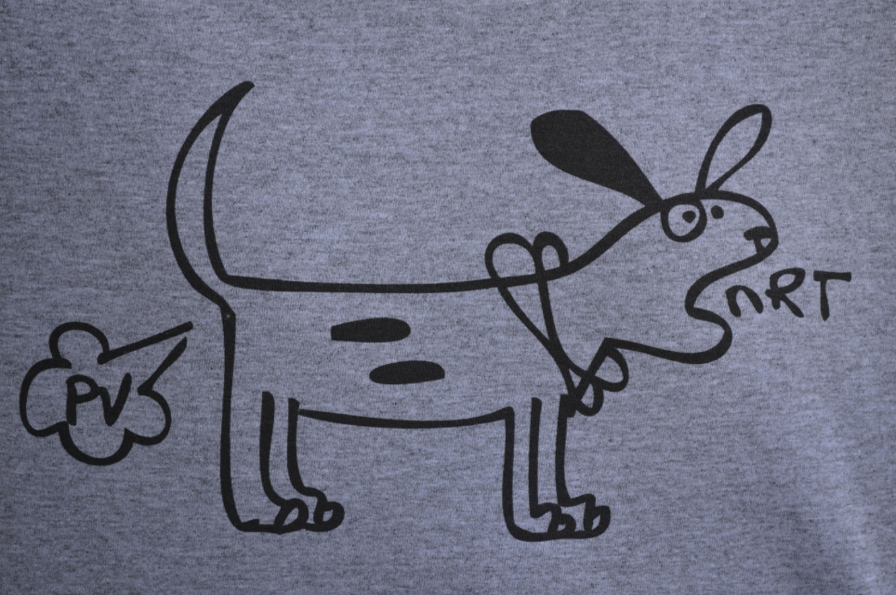
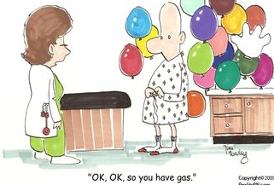
Gas Laws
Jed Wolpaw MD, M.Ed
Sept 2, 2015

Slide 3
Agenda
Introductions
Vapor Pressure
Anesthetic concentration
Vaporizer Types and safety features
Uptake and elimination
Effects of ventilation and circulation
Concentration effect
Second gas effect
Nitrous Oxide in closed spaces
Tips and Tricks for anesthesia and life
Questions

Slide 4
Vapor Pressure
Which inhaled anesthetic gas has the highest vapor pressure?
A: Sevoflurane
B: Desflurane
C: Nitrous oxide
D: Halothane
Notes:
At 20 degrees
Sevo: 157
Des: 669
Iso: 238
En: 172
Hal: 243
Nitrous: 38,770

Slide 5
Vapor Pressure
Which inhaled anesthetic gas has the highest vapor pressure?
A: Sevoflurane 157
B: Desflurane 669
C: Nitrous oxide 38,770
D: Halothane 243
Notes:
At 20 degrees
Sevo: 157
Des: 669
Iso: 238
En: 172
Hal: 243
Nitrous: 38,770

Slide 6
What is vapor pressure?
Definition?
In a closed container, molecules from a volatile liquid escape the liquid phase and become vapor. They strike the wall of the container exerting pressure.
Directly proportional to what? Why?
Temperature
Because increasing temperature will increase the ratio of gas:liquid molecules
Notes:
Directly proportional to temp bc increasing temp increases ration of gas: liquid molecules

Slide 7
If you accidentally filled your sevo vaporizer with iso, what would happen?
You would deliver an overdose of inhaled anesthetic
Why?
Vapor pressure of Sevo 157
Vapor pressure of Iso 238
Variable bypass vaporizer is agent specific—will direct flow based on sevo’s VP

Slide 8
HI-C (HI-SE)

Slide 9
HI-SE
Halothane 243; Isoflurane 238
Sevoflurane 157; Enflurane 172

Slide 10
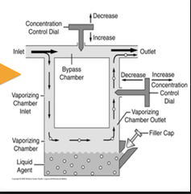
Variable Bypass Vaporizers
Which inhaled anesthetics use variable bypass vaporizers?
Sevo, Iso, Enflurane, Halothane
Not shown: Temp compensation
Notes:
Temp compensating valve causes more flow to bypass the anesthetic chamber when ambient temp increases

Slide 11
Vaporizers
Which inhaled anesthetics do not use variable bypass vaporizers?
Desflurane and Nitrous
Nitrous is piped in through a flowmeter, the same as O2
Why not Des?
A: It’s newer so it gets a newer vaporizer (Tec-9)
B: It’s too hot and needs a special heat absorbing vaporizer
C: Des is bananas, B.A.N.A.N.A.S
D: It is too unstable because it’s vapor pressure is close to atmospheric pressure

Slide 12
Vaporizers
Why not Des?
A: It’s newer so it gets a newer vaporizer (Tec-9)
B: It’s too hot and needs a special heat absorbing vaporizer
C: Des is bananas, B.A.N.A.N.A.S
D: It is too unstable because it’s vapor pressure is close to atmospheric pressure

Slide 13
Des is bananas?

Slide 14
Desflurane vaporizer (TEC-9)
Heated to 39 degrees increasing VP to 1300-1500mmHg
External heat source prevents freezing from consumption of heat when Des vaporizes
Remember latent heat of vaporization (number of calories for 1g to go from liquid to vapor without changing temperature)
Des consumes more heat because it is less potent, thus more molecules are “taken away” to be used, and more has to be vaporized
Des vaporizer adds des directly into gas stream (no bypass chamber)

Slide 15
Desflurane vaporizer

Slide 16
Altitude
What happens when you use a variable bypass vaporizer at altitude?
A: Overdose
B: Underdose
C: You deliver basically the same concentration
D: You can’t, they’re too heavy to carry all the way up the mountain

Slide 17
Is the mountain too high? Name that movie

Slide 18
Altitude
What happens when you use a variable bypass vaporizer at altitude?
A: Overdose
B: Underdose
C: You deliver basically the same concentration
D: You can’t, they’re too heavy to carry all the way up the mountain

Slide 19
Altitude
At altitude where pressure is ½ sea level (380) if you dial in 2% iso you will get…?
4% Iso
But you don’t overdose…why?
4% of 380 is the same as 2% of 760
In practice the vaporizer slightly overcompensates so you get a small increase at altitude in the delivered anesthetic

Slide 20
Altitude with Desflurane
Why would Des be different at altitude?
Remember there is no bypass chamber
The machine delivers not a partial pressure but an actual percentage
At 380 torr if you dial in 6% Des what percent of your sea level dose will you give?
A: ¼
B: ½
C: The same
D: 1.5x

Slide 21
Altitude with Desflurane
At 380 torr if you dial in 6% Des what percent of your sea level dose will you give?
A: ¼
B: ½
C: The same
D: 1.5x
Remember: They made it to be safer (better to underdose)

Slide 22
Volatile Anesthetic Uptake
The most important thing to understand for boards is FA/Fi ratio
What is the FA/Fi ratio?
Ratio of alveolar concentration to inspired concentration
What is the ratio at the beginning of an inhaled induction?
FA is zero, Fi is very high
As FA approaches Fi, induction occurs. WHY?

Slide 23
Volatile Anesthetic Uptake
Whatever happens between the inhaled air and the alveolus also happens between the blood and the brain
In other words, when the Alveolus is saturated, SO IS THE BRAIN
This means that LESS Soluble anesthetics have FASTER onset and offset
Don’t think about it getting into the blood faster if it’s soluble. It will get into the blood no matter what
The KEY is that if it is NOT soluble it will STAY IN THE BRAIN and induction will be faster

Slide 24
Intracardiac shunts
What effect does a R→L intracardiac shunt have on the rate of inhaled induction of anesthesia?
A: Faster induction
B: Slower induction
C: Unchanged
Induction is slower. Why?
You are diluting the anesthetic concentration in the blood heading to the brain
This effect is greater for poorly soluble agents (Des, Sevo) and less for highly soluble agents (Iso, Enf, Hal) because the dilution is more significant

Slide 25
Intracardiac shunts
Right to Left (IV):
rapid induction (easy to remember – blood bypasses lungs, straight to brain)
Right to Left (volatile):
slower induction
Left to Right (IV):
little effect on induction
Left to Right (volatile):
little effect on induction

Slide 26
Solubility Coefficient
What is the blood-gas solubility coefficient?
Ratio of the amount dissolved in blood to the amount dissolved in air
So the higher the number the more soluble (more in blood, less in air)
Halothane: 2.54
Enflurane: 1.90
Isoflurane: 1.46
Sevoflurane: 0.69
Desflurane: 0.42
N2O: 0.46

Slide 27
Alveolar Ventilation
What effect does increased alveolar ventilation have on inhaled induction?
Increases rate of induction BUT depends on solubility…how?
Larger impact on more soluble agents…why?
It “disappears” faster so replacing it will increase FA/Fi more. With poorly soluble, it doesn’t disappear so it’s still there so delivering more has less effect

Slide 28
V/Q mismatch
Endobronchial intubation
One lung gets twice the minute ventilation and the other gets none
The lung that gets no gas will contribute blood with no anesthetic, so induction is slowed. The question is, does it vary with solubility?
YES! Why?
For poorly soluble gas the FA/Fi doesn’t change much with the doubled minute ventilation but for highly soluble gasses it does
So for the ventilated lung, you have a bigger CHANGE in your rate of rise of FA/Fi with more soluble anesthetics so V/Q mismatch slows their onset LESS
In other words, with V/Q mismatch onset is slowed MORE for poorly soluble agents

Slide 29
Cardiac Output—a tough one
Higher cardiac output has what effect on rate of inhaled induction?
SLOWS the rate of induction… WHAT? But doesn’t it carry more to the brain?
But it carries it away from the alveoli, decreaseing FA/Fi and slowing induction
Remember: It’s all about FA/Fi. Think: Yes, it goes to the brain, but it goes everywhere else too and if it is soluble it will dissolve OUT of the brain
This effect is more pronounced for which? Soluble or Insoluble?
Soluble, because FA/Fi will decrease more as more is taken away from the alveolus

Slide 30
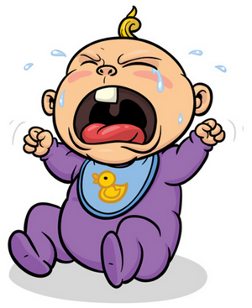
INFANTS

Slide 31
Infants
2 important factors: Higher alveolar ventilation, lower FRC, these have what effect?
Faster induction. Why?
Higher alveolar ventilation introduces more agent, rapid rise of FA/Fi
Lower FRC means smaller reservoir for agent to “escape to” so faster rise in FA/Fi

Slide 32
Concentration effect
The rate of rise of FA/Fi is accelerated by high initial concentration of agent
Only clinically relevant with nitrous
When some is taken up into blood from alveoli, whatever is in the bronchus will get “sucked in” and if it has a high concentration the FA will rise quickly

Slide 33
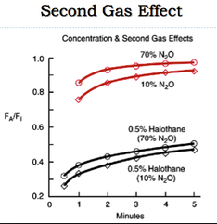
Second Gas Effect

Slide 34
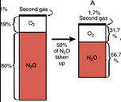
Second gas effect
Nitrous is 20x more soluble than O2 or N2 (even though it is “poorly soluble”)
So it is taken up faster than it can be replaced in alveolus
For a time this increases the fraction of the second gas that is still there

Slide 35
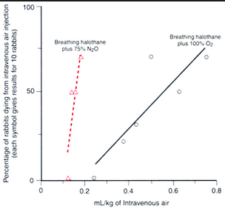
Nitrous in closed spaces
What happens when you use nitrous in someone with an air embolus?

Slide 36
Nitrous in closed spaces
What happens when you use nitrous in someone with a PTX?
PTX doubles in size in 10 min on 50% nitrous, 4x the size on 75% nitrous
Eye cases? Ear cases?
Endotracheal tube cuff?

Slide 37
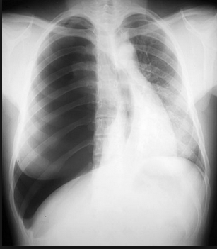
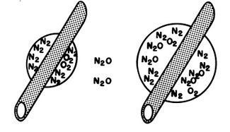
Nitrous in closed spaces

Slide 38
Summary
Know your vapor pressures, HI-SE (~240, ~160); Des 670
Altitude (Des gets underdosed, the rest get slight overdose)
FA/Fi: less solube=faster onset because FA/Fi rises faster
Factors affecting onset
Alveolar ventilation: Speeds onset, more for soluble
R→L shunt: Slows onset, more for insoluble
V/Q mismatch: slows onset, more for insoluble
Increased Cardiac output: Slows onset, more for soluble
Being an infant: Speeds onset (higher alveolar vent and lower FRC)
Concentration and second gas effects: Nitrous increases rate of rise of itself and other inhaled anesthetics
Nitrous in closed spaces expands rapidly

