Slide 1
Today’s Healthcare Headlines
Supply Demand Shifts
Outcomes, Quality
Payment Reform
Tomorrow’s Anesthesia Trends

Slide 2

A New Physician Workforce

Slide 3

The Coming Physician Shortage

Slide 4
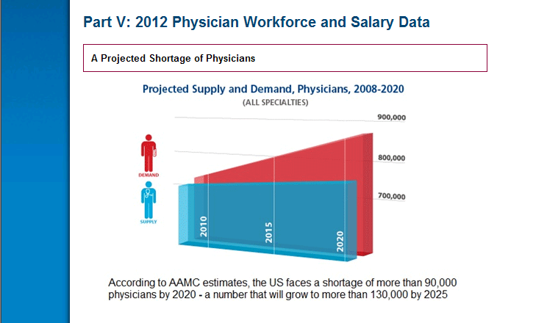
Association of American Medical Colleges

Slide 5
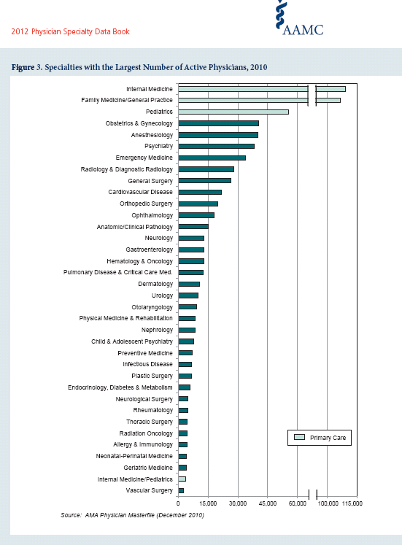

Slide 6
2014
Age of Current U.S. Physicians
Under 30 0.8%
30-39 19.8%
40-49 24.4%
50-59 23.6%
60-69 20.0%
70+ 10.9%
916,264 with active license
Over 30% are 60 or older!
Source: AMA

Slide 7
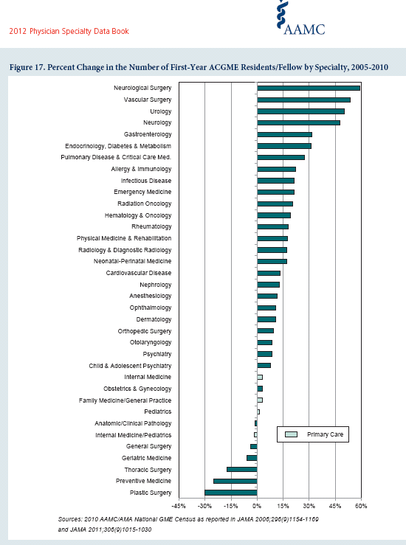
Anesthesia had 11.7% increase from 2005 - 2010

Slide 8
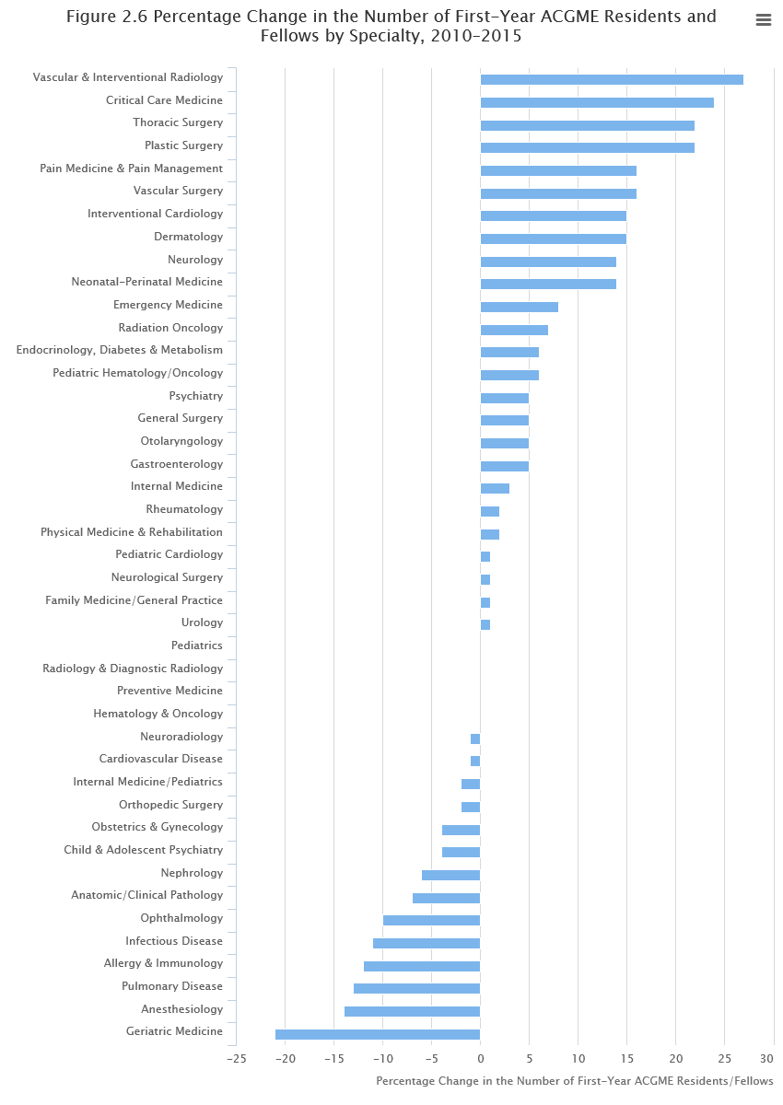
2016 Physician Specialty Data Report

Slide 9
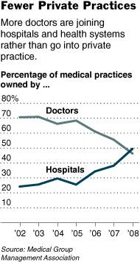

Slide 10
Multigenerational Workplace

Slide 11
The Four Groups
Traditionalists
Baby Boomers
Gen X’s
Millennials

Slide 12
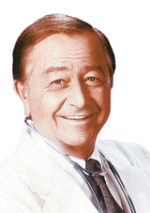
Traditionalist
Works like crazy
Hippocratic oath
“I’ll take call – it’s my responsibility”
“Real doctors round on their patients”
44% would retire today if they could
“Offboarding”
“Clydesdales”
“Weary warriors,” dedicated, white coats/ ties, on time, poor team members

Slide 13

Baby Boomer
“I’ll take call if you pay me”
“Stubborn Donkeys”
Driven, materialist
No coat/tie
Good team members

Slide 14

Gen X
“I’ll take call for lots of money”
“Mustangs”
Cynical
Suspicious
Question Authority
Disdainful of Boomers
CarpeDiem

Slide 15
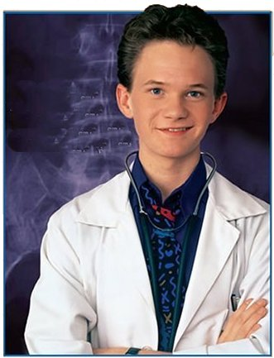
Millennials
Work/Life balance
EMR a must
Hippocratic oath-text it to me
“I won’t take call for any price”
“Shetland Ponies”
Casual dress
iPhone w/apps
Great team members
Technology
Constant validation

Slide 16
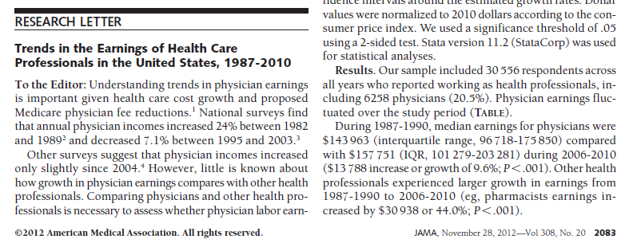
Slow growth due primarily to:
  “include managed care growth, Medicaid, payment cuts, sluggish Medicare payment growth, or bargaining by insurance companies.”

Slide 17
Why Now?
Medicare Improvements for Patients and Providers Act – 2008
  Mandate CMS to move to ‘value-based purchasing’ program (VBP)
2009 “Call to Action” – Senate Finance Committee
  “Refocusing payment incentives toward quality”.
  “One concept that offers promise for greater efficiency and care coordination is the idea of allowing Medicare to pay bundled or global payments for all services provided to a patient during hospitalization”.
ARRA / HITECH - 2009
  American Recovery and Reinvestment Act
    Health Information Technology for Economic and Clinical Health

Slide 18
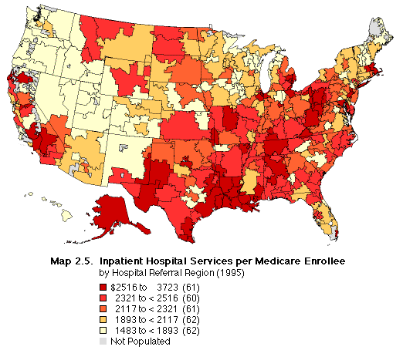
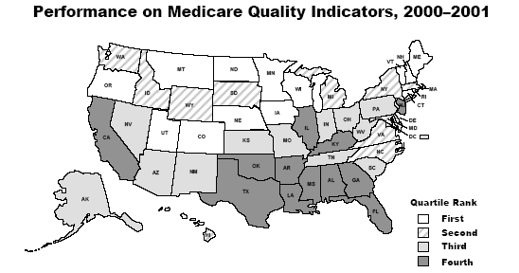

Practice Variation & Cost of Care
9/14/09
18

Slide 19

Healthcare Reform

Slide 20
Payment Reform
Efforts to create models that reduce focus on volume and reward quality instead:
  Bundled Payments
  Accountable Care Organizations (ACO)
Attorney/Consultant Opportunities!

Slide 21
Bundled Payments
Fee for Service
Capitation
Rewards volume over value
Underuse
Risk adjustments
Combines payments with quality measures

Slide 22
PQRS
Successful demonstration of meeting 80% compliance with PQRS – 1.5 % CMS bonus.
Will become a 2% penalty in 2015.
Cost of implementing PQRI program – potentially significant using paper records.
Effect of demonstration that your group is in 90th percentile of CMS providers – priceless!!

Slide 23


Our Future

Slide 24
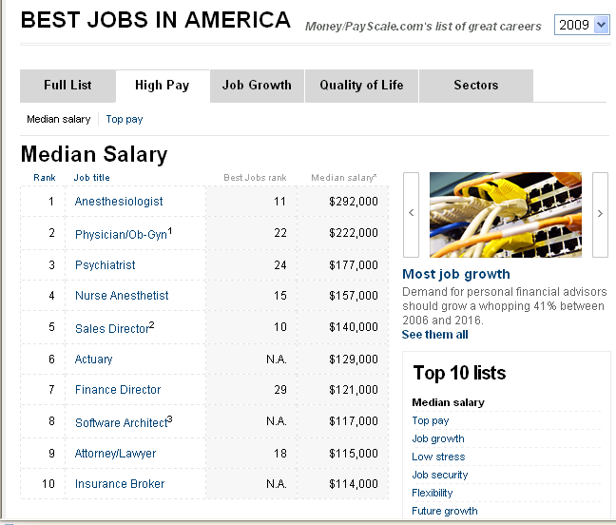
CNN – Highest Paid Job http://money.cnn.com/magazines/moneymag/bestjobs/2009/highpay/index.html

Slide 25
SAAC Salary Survey 2000 vs 2007
National Average (50th %)
Academic Title | 2000 | 2007 | % Increase
Instr. | 144,250 | 256,000 | 78%
Asst. | 183,000 | 274,000 | 50%
Assoc. | 210,000 | 301,000 | 43%
Prof. | 239,182 | 311,000 | 30%

Slide 26
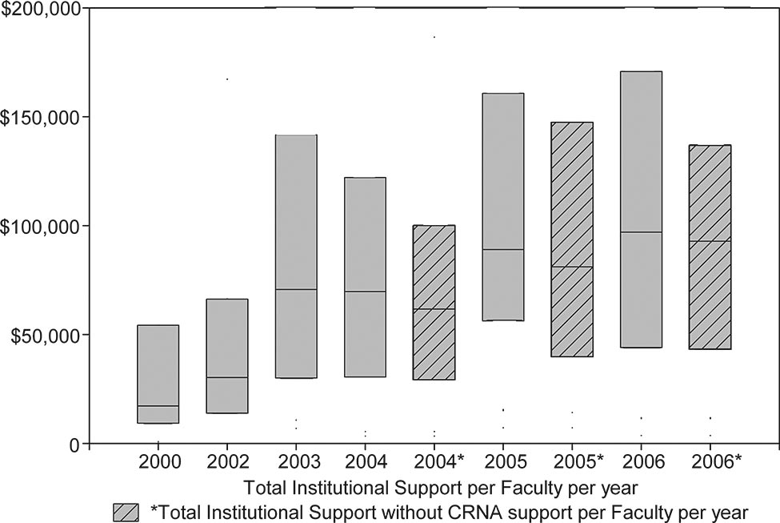
Hospital Support
Tremper, A&A 2009

Slide 27
Anesthesiologist / CRNA salary bubble of 2018?
(real or perceived
oversupply)

Slide 28
Increased Supply
Increased number of residents and CRNA’s graduating training programs
Relaxed supervision requirements
Delayed retirement (economic uncertainties, investment losses etc)
Hospital/ASC closure

Slide 29
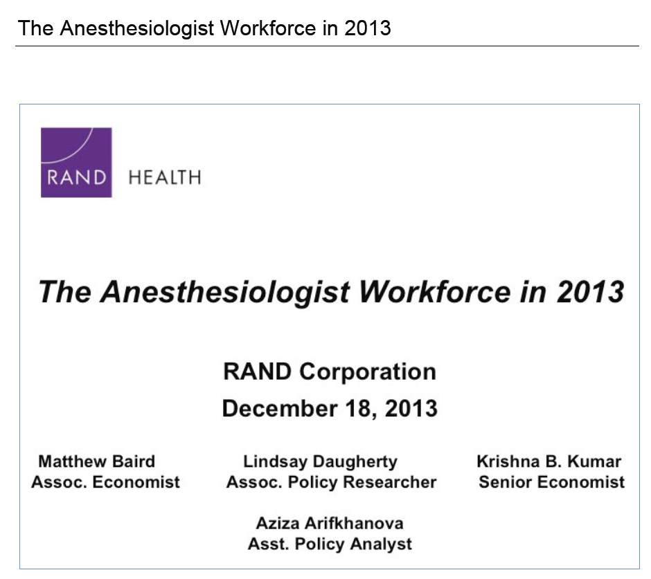

Slide 30
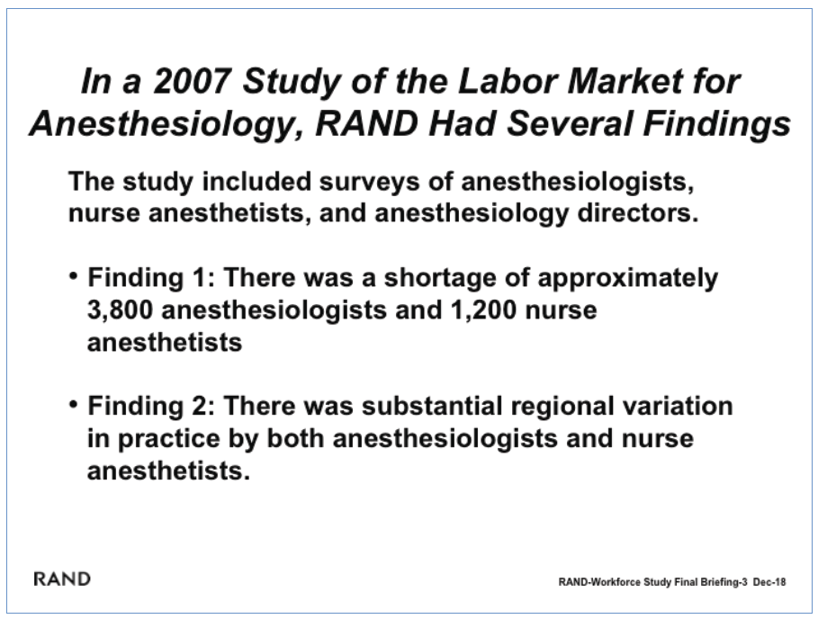

Slide 31
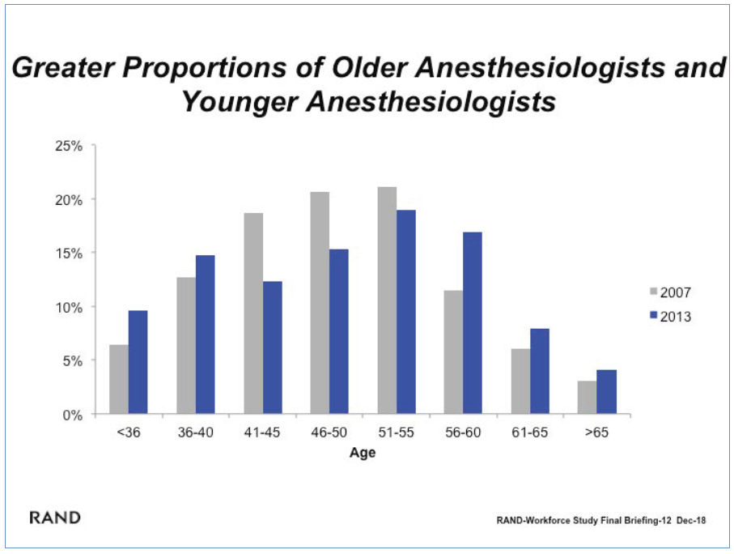

Slide 32
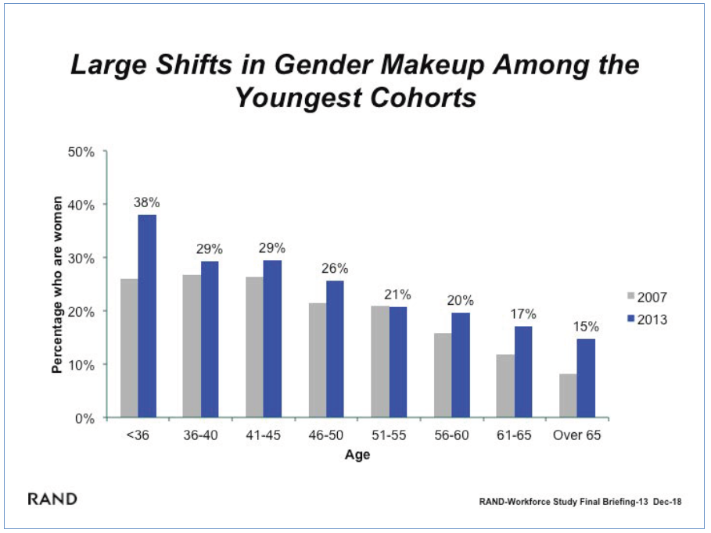

Slide 33
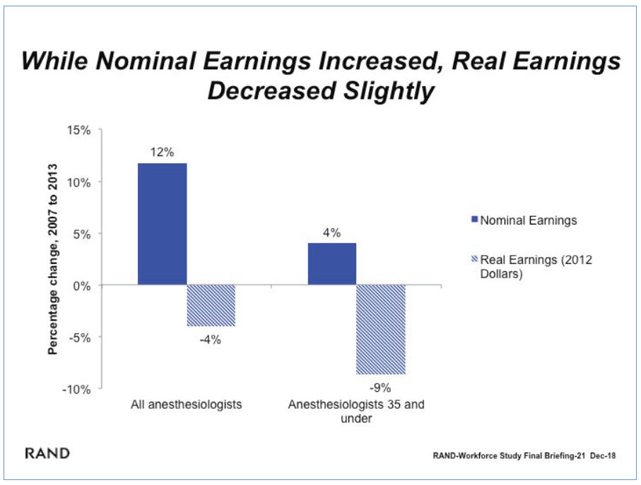

Slide 34
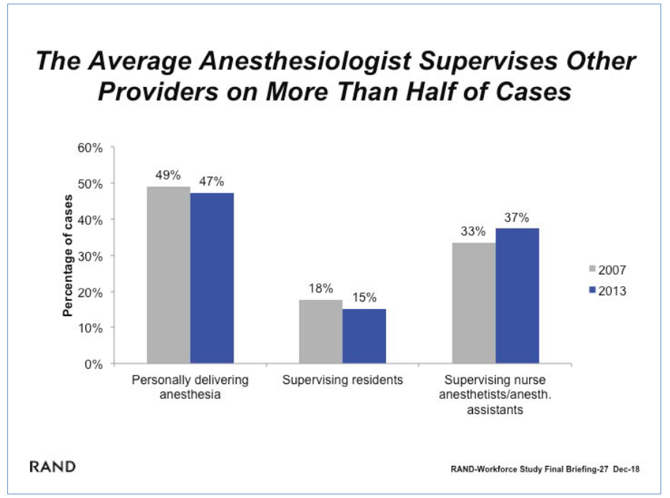

Slide 35
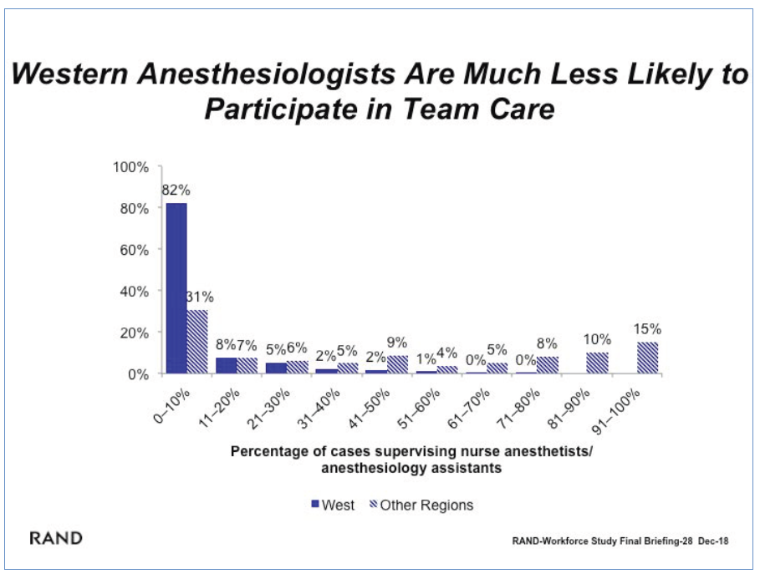

Slide 36
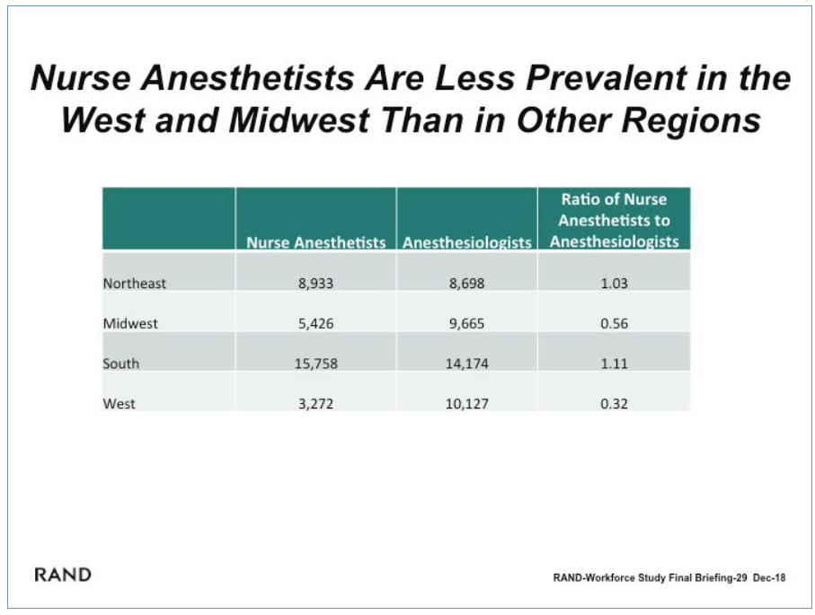

Slide 37
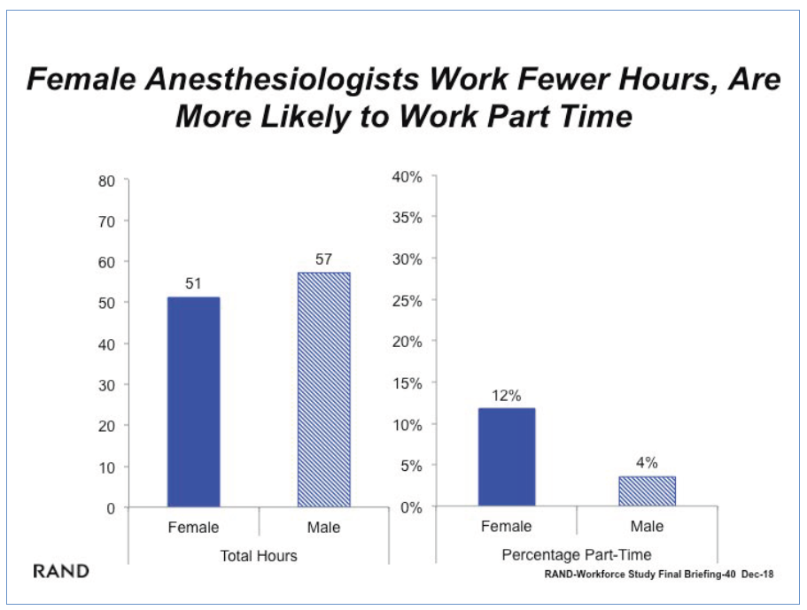

Slide 38
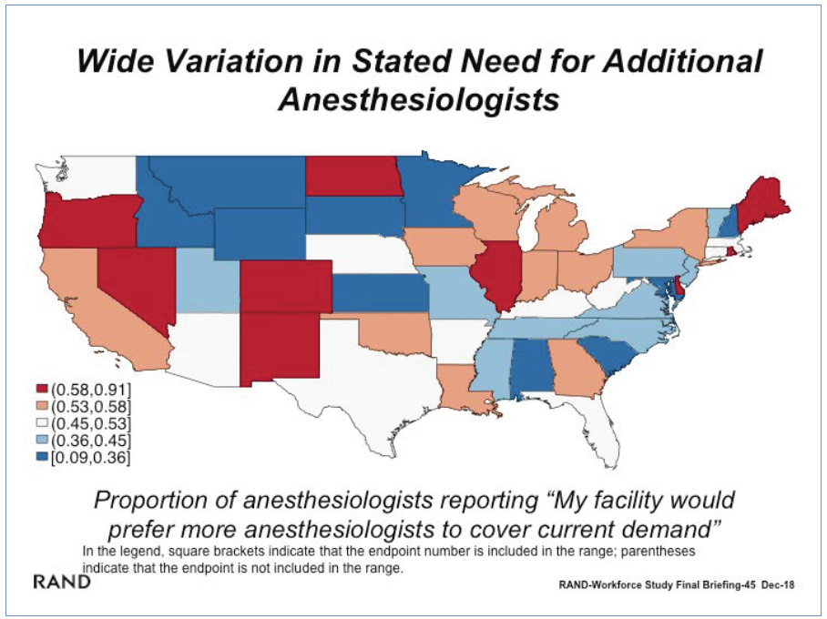

Slide 39
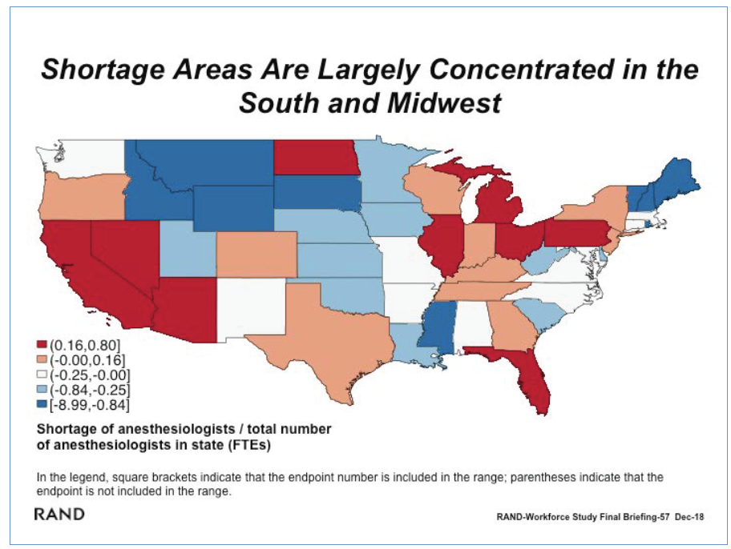

Slide 40
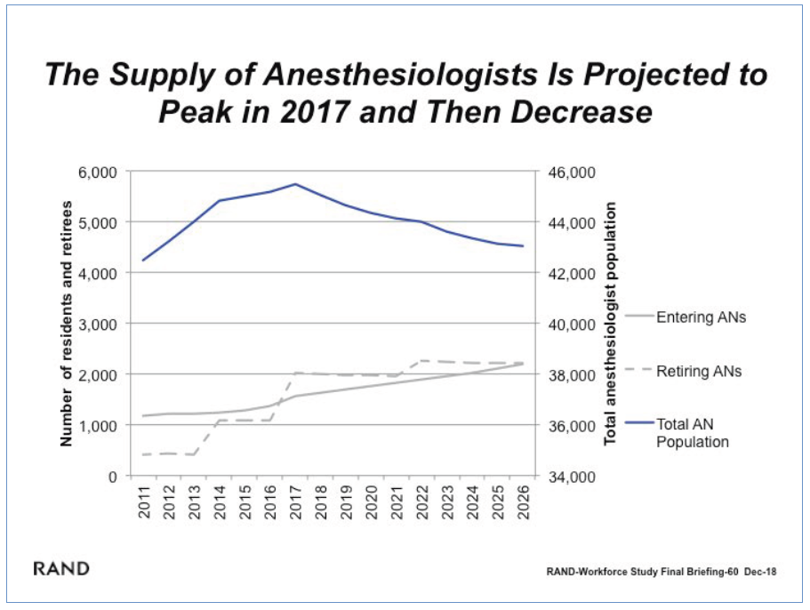

Slide 41
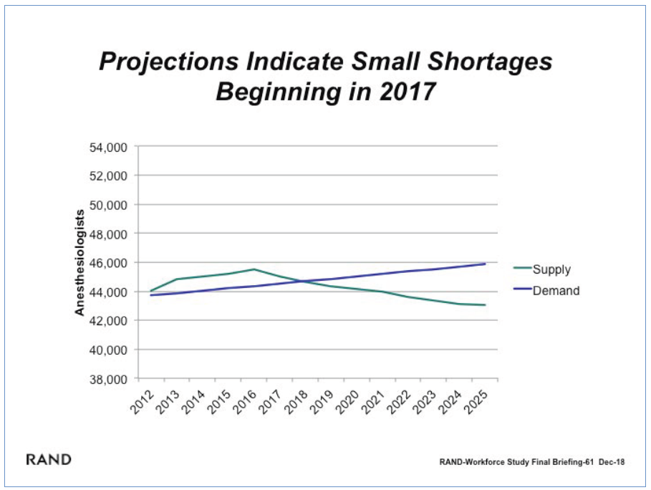

Slide 42
Potential impact of supply/demand changes
Hospitals have easy access to replacement providers – Don’t negotiate anymore
Reductions in provider compensation
  Need to renegotiate subsidy arrangements
  Difficult negotiations with providers next 1 to 2 years
  Big players – Sheridan, Pediatrix, Pinnacle grow stronger
Reduction in GI sedation and other out of OR anesthesia demand
Movement of anesthesiologists into pain management, critical care, etc.
Focus of anesthesiologists shifted to more difficult cases and to the broader “peri-operative physician”

Slide 43

Subsidies: CEO’s strike back!

Slide 44

Great Philosopher
Wayne Gretsky
Skate to where the puck is going to be

Slide 45
Trends
Presented by Dr. Robert Johnstone, 2012 ASA, Washington, DC

Slide 46
Trend #1
Increasing demand for anesthesia services ‘out of OR’
  Gasworks:
    Open positions for Anesthesiologists – 679
    Open positions for CRNAs – 573

Slide 47
Trend #2
Percentage of Anesthesia mid-level providers increasing:
  Currently ≈ 40,000 MD providers
  Currently ≈ 40,000 mid-level providers
  % will change over next decade
  2010 Rand Corporation study predicts:
    Shortage of 4,479 MDs and surplus of CRNAs of 7,970 by 2020

Slide 48
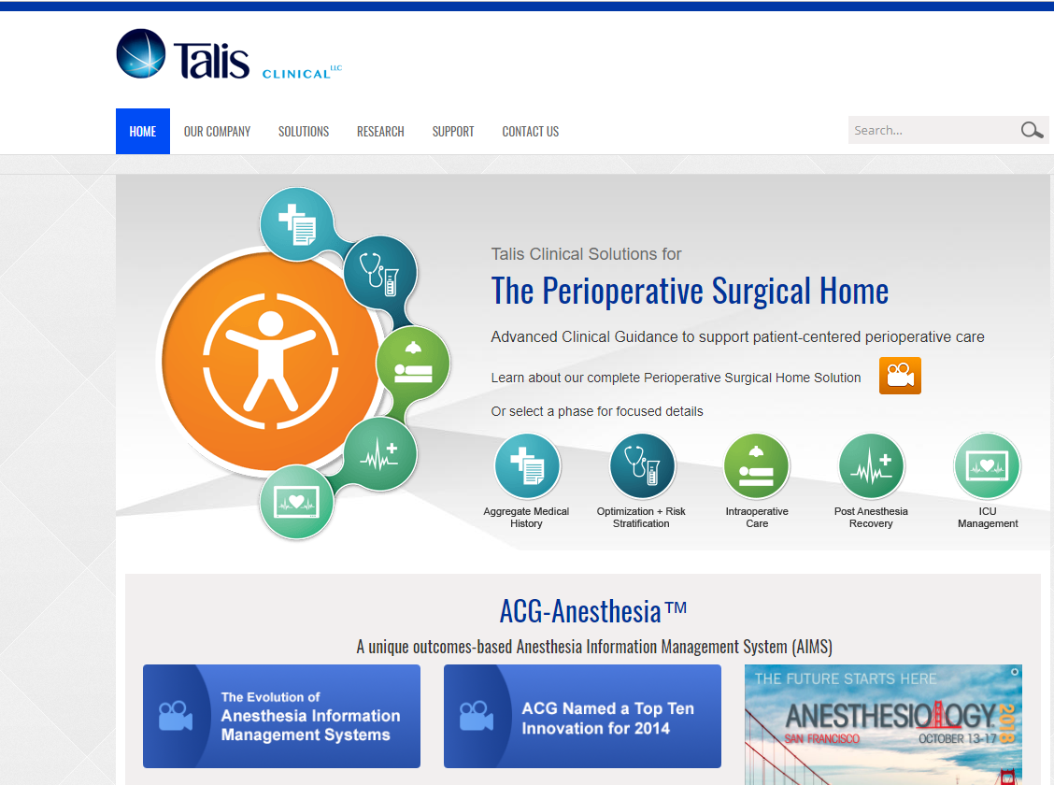

Slide 49
Trend #3
More anesthesiologists working less than full time:
  2011 study by Cjeka 22% male and 44% females work part time
  Two fastest growing demographics:
    Men at end of career
    Women at beginning of career
  Locums tenens becoming popular mode of practice

Slide 50
Trend #4
Hospital employment of anesthesia increasing
  Most are adopting lower salary with incentives based on performance and quality metrics
  Recent Price Waterhouse study indicates 46% of physicians interested in employment
  Current subsidization of anesthesia groups > 80%
  Beware of the ‘Company Model’

Slide 51
Trend #5
Healthcare reform is changing priorities of anesthesia practices
  Costs of implementing new federal regulations is driving groups towards consolidation
  Efforts to increase anesthesia exposure in bundled payments is focused on the perioperative setting

Slide 52
Trend #6
New technology is driving need for subspecialists
  Ultrasound guidance blocks
  TEE for cardiac
  Pain management
  Knowledge of informatics
  Some increased compensation for these skills, and decreased comp purely on longevity

Slide 53
Trend #7
Anesthesia groups expanding in size and location:
  Three groups are publicly traded
  > 15 groups have greater than 500 clinicians or work in more than 3 states
  Private equity currently buying out existing groups

Slide 54
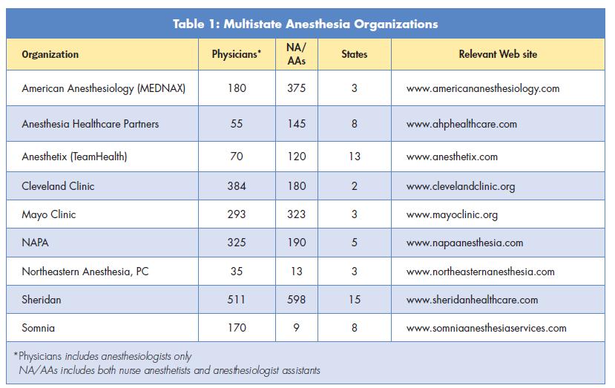
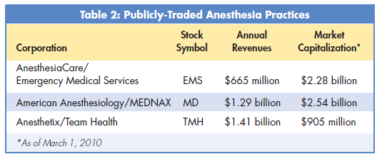
Maccioli G, Johnstone R. ASA Newsletter, 2010 74(5): 12-14

Slide 55
Questions?

